Slide 1
digital events studies: from constructivism to connectivism
Clare Hearn & Heather Serdar, Falmouth University AEME JULY 2018
Notes:
Clare Hearn is Senior Lecturer in Cultural Management and Production at Falmouth University. She is responsible for developing the content of the MA Creative Events Management for which she won the Staff Excellence Award for Outstanding Innovation in Teaching 2016, and which was shortlisted for the international Learning Technologies award Best Online Distance Learning Programme 2017.
Heather Serdar worked as a programme leader and senior lecturer at the University of East London for 11 years. She currently works as a freelance consultant in instructional designer and e-learning in the higher education sector. Heather lead on the programme design of the MA – and she taught me everything I know about online learning design.
This presentation is the first (arguably) coherent collection of thoughts, theories and data that will go on to be submitted in refined form to IJEFM and ALT.

Slide 2
content
Theories of online learning and connective action
Research – defining and delivering digital events
Notes:
Background to research
Essentially, this presentation presents the learning theories behind the MA - social constructivism, collectivism and connectivism - and then focuses on a an example of our social learning approach – the search for of a definition for ‘digital events’, which the students undertook through a series of group activities.
Creating the MA, Heather and I became interested in some parallel developments, on which there is as yet, relatively little research – 1. collaboration in instructional design for online environments, 2. the evolution of networked digital events, and 3. the drive for co-creation in event design - all of which are largely facilitated through social media, and activated through connectivism.
The MA, charting as it does the conversations with and between students, and which is still in its first iteration, with its first cohort now embarking on their theses, is providing a rich source of primary data on each of these developments.
The idea of creating a shared definition came when when I was creating the *thick descriptive content - I found myself writing and voicing the words ‘ there are multiple definitions for …‘ whatever it was I was talking about. The students, in their (costly) search for absolutes (recalled facts mean marks), were instead faced with uncertainty and ambiguity. What is an event? What is design? What is digital? And in our module ‘Digital Futures for Events and Events Marketing, ’what is a digital event?’
*Geertz described the practice of thick description as a way of providing cultural context and meaning that people place on actions, words, things, etc. Thick descriptions provide enough context so that a person outside the culture can make meaning of the behaviour.

Slide 3
theories of online learning
MA CEM
Falmouth
Connectivism
Social constructivism
Co-creation
Collaboration
Notes:
Social constructivism
Social constructivism posits that human development is socially situated and knowledge is constructed through interaction with others. Peter L. Berger and Thomas Luckmann, The Social Construction of Reality
Our working definition of events is a product of social constructionism; it is an artifact, collectively arrived at. The social process through which the students developed that collective definition is an example of social constructivism.
In an online course, the activities and texts produced within the group as a whole help shape how each person behaves and develops within that group. A person's cognitive development is influenced by the culture that he or she is involved in, such as the language, history and social context.
In essence, what is a piece of collaborative formative assessment becomes a vehicle to create the benefits of social constructivism and social co-participation in learning. There is a movement away from extrinsic validation of learning to intrinsic self-validation, and evidence of students developing deep approaches to learning. (McConnell, David. E-Learning Groups and Communities, 2006: 143)
Connectivism
Connectivism, promoted by Downes and Siemens, is a key learning theory for a digital age. It seeks to explain the complex learning and sharing of knowledge in online environments in a rapidly changing social digital world.
In connectivist learning, a teacher will guide students to information and answer key questions as needed, in order to support students learning and sharing on their own. They are encouraged to independently seek information, to express what they find in various online contexts, thus creating a connected network in online communities (of practice). Learners, influenced by the diversity of networks, are encouraged to recognise and interpret patterns in global contexts and to transfer knowledge.
Connectivism is core to the instructional design of the MA – consequently, it is driven by the understanding that decisions are based on rapidly altering foundations, with new information being constantly received and created. This relentless and rapid evolution of digital landscapes demands that the students create their own digital event realities based on constant and ongoing research. This is their currency. And importantly, the critical aspect of the MA encourages development of the ability to draw distinctions between important and unimportant information
Co- creation
Co-creation is a relatively new phenomenon for consideration in event management and event studies. Getz (226:2016) notes that at the leading edge of events, event designers are working to free us from the constraints of time and space, and suggests that co creation is a key part of this.
The evolution of co-creation is demanding that we re-think the traditional terms of 'designer’, and 'user’ or audience’ 'participant’ to consider the mutually responsive nature of truly co-creative projects – they consist as a conversation, in which everything that is said always exists in response to things that have been said before and in anticipation of things that will be said in response.
One of the challenges of the co-creative approach is the concept of user or audience as 'the unruly other, a stranger and outsider who needs to tamed and trained [in order that they] do not disturb our careful controlled processes.’ (McCarthy and Wright 8:2017). Participants can no longer be considered instruments for realising the creative ambitions of others, but instead as creative people making things happen alongside or indeed potentially without the designer or teacher or manager.
(Or at least, this is what we tell the students when they react with terror to the thought of another group assignment…)
It can be argued that most co-creation objectives can be classiﬁed into one of the following three categories:
Generation objective: to solicit ideas, suggestions or designs from collaborators and other stakeholders, through contests or open-ended appeals, for subsequent use in the design and development of events.
Reﬁnement objective: to enable work between collaborators and event management to reﬁne one or more features of an event to help improve its performance.
Creation objective: collaborators work together to develop a prototype of an entirely new event (in almost all cases the resulting prototype needs additional reﬁnement and improvement before it is ready for delivery).
Collaboration
Collaboration ‘is a process through which parties who see different aspects of a problem can constructively explore their differences and and search for solutions that go beyond their own limited vision of what is possible’ (Gray cited in Gray & Wood 1991).
True collaboration involves relinquishing some control in order to achieve shared goals (collaboration itself can be a goal). Collaboration theory relates to how stakeholders come together and work together in many formal and informal formats. Collaboration theory is comprised of many related theories including resource dependency and strategic management theory.
Informed by Lev Vygotsky, Soviet psychologist, Social Development Theory, which characterises creativity as a social process of collaboration that can involve intense and prolonged engagement and interaction.
Importantly, it notes that collaboration is non-hierarchical (think of the democratizing effects of the internet) and often starts as one pattern and over time changes into another pattern.
So, in the spirit of collaboration, the let us first consider the word ‘event’.
Do we have a shared consensus as to its definition? Do we consider it to be one thing when discussing event management as an academic discipline or profession, but another when discussing our everyday lives?
Is an event…
‘A thing that happens or takes place, especially one of importance’? OED
the ‘arrival of a significant point in time’ (Business Dictionary)?
As Andrews and Leopold comment, ‘the term has been used to describe a disparate range of activities without any clear justification or real definition’ (2013:3).
In this new era of critical discourse, the definition of events underpinning this MA is Robinson and Picard’s, ‘societal disruption’ – this allows an expansion from established modes of thinking about events, to a more nuanced understanding of them as social, cultural and political phenomena, both planned and unplanned, physical and virtual.
As part of our Digital Futures module, we explore digital events from a range of critical and managerial perspectives – but first we ask our students to define the parameters, the nature and the possibilities of, digital events.
We suggest that this collective body of thought, arrived at through discussion and digital event design and delivery, exists as a repository of active research, contributing to the nascent literature addressing this newest of phenomena.
Ask audience ‘what are digital events’? Ask for examples to share with group

Slide 4
what is a (digital) event?
National theatre Live – series of live broadcast screenings making theatre more accessible (filmed in front of a live audience)
Samsung digital VR – i.e. use of headsets in an immersive dome at British Museum 2015 - visitors will be able to explore a virtual reality Bronze Age site designed by Soluis Heritage
PCMA conference – surrogate attendees i.e. ipad worn by hired attendee, acting as a ‘human uber’
Coachella festival – use of technology i.e. visualisation of 2pac
VR experience in retail stores – i.e. experiential marketing campaign by Arc'teryx
Notes:
We created a series of online discussion fora, 2 per week, throughout the 15 week module. These were created as a shared repository of our notions of the digital, with relation to events. As there is no single definition of what constitutes a digital event, the students were tasked with identifying an initial current shared understanding of the term.
The rapid innovation and adoption of the digital has created a vacuum of understanding, which academia and industry alike are trying to address.
The students as a group, are from multiple cultures and nations, they work in various industries, are a range of ages from 20 – 50 and are from various social backgrounds. They presented the following as exemplary:
National theatre live – series of live broadcast screenings making theatre more accessible (filmed in front of a live audience)
Samsung digital vr using headsets in an immersive dome at British Museum 2015 weekend of visitors will be able to explore a virtual reality Bronze Age site designed by Soluis Heritage, where they will see 3D scans of objects from the Museum’s collection of this period, placed in their original setting.
PCMA – surrogate attendees – ipad worn by hired attendee – human uber
Coachella – use of tech 2pac
VR experience in retail stores – experiential marketing campaign by Arc'teryx
So, these, on first consideration were what they considered digital events to be. So our first shared definition might be:
a connective, technologically enabled experience …
Later discussions, framed in slightly different ways, featured terms such as:
live, co-created, global, levelling, collective.
But what about in practice? What digital events did our students actually make?

Slide 5
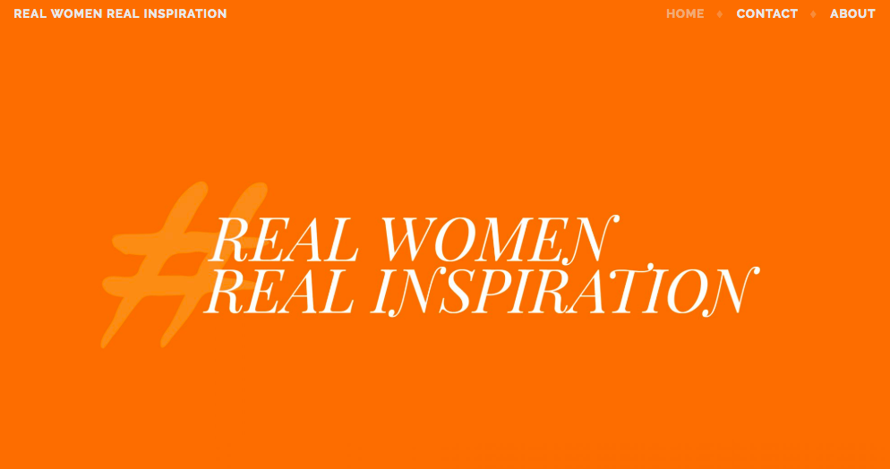
our digital events
Notes:
In collective practice, that is in the events that they designed and delivered in April and May this year, our students decided that digital events were:
Inclusive Live – live streamed concert (Discord) of singer/songwriter Kat Little, who has autism, promoting inclusivity and raising awareness of hidden disabilities, parallel campaigns on multiple social media platforms
Real Women, Real Inspiration – social media campaign, on multiple platforms, composing user generated content, managed over 2 week period, designed to raise awareness of positive stories of female achievements within the workplace
Everyone is an Artist – series of 6 synchronous online structuristic art technique workshops delivered to ticketed participants with ED, funded by Structuristic Art Foundation
Lets Do Science – a series of social media campaigns with live science experiments delivered over 2 weeks, encompassing DNA Day, that encourage families to try out simple science experiments at home and share results, designed to promote science in education and as profession
What did these events all share? What common aspect defines them?
Powerful connection, as well as connectivism, only possible as a consequence of the digital technology enabling them
‘Nell came away and said the other children had the same teeth as her, it was the first time that she had seen anyone with the same condition as her, and I feel it has helped her so much’
So, this is where we currently are … or were in April and May!

Slide 6
creative collaboration
‘In partnerships we see ourselves through the eyes of others, and through their support we dare to explore new parts of ourselves. We can live better with temporary failures as we rely on our partners' strengths.
By joining with others we accept their gift of confidence, and through interdependence, we achieve competence and connection. Together we create our futures’
(Vera John-Steiner 2006:203)
Notes:
I’d like to close with this quote from Vera John-Steiner, from Creative Collaboration, 2006
Bishop suggests that rather than the perfect delivery of a vision, quality could be conceived instead 'as a way to understand and clarify our shared values at a given historical moment’ (cited in McCarthy & Wright 6:2017) and that this should be our aim - if we create a moment that demonstrates the nature of ‘us’, then we have created something of quality.

Slide 7
thank you…
thoughts, questions, collaborations?!
clare.hearn@falmouth.ac.uk

