Slide 1
REF2021 Portfolio Template

Slide 2
Showing Saying: On Speech Balloons
Name: Lizzie Ridout
Falmouth Department: School of Communication; BA Hons Graphic Design
Project Title: Showing Saying: On Speech Balloons
Significant Dates: Publication 2014
Falmouth Research & Innovation Programme Area: Storytelling & Inequality

Slide 3
Table of Contents
Page 4) 300-word Statement
Page 5) Visual Record of Output
Page 6–9) Previous Supporting Work
Page 10) Links to Media Record of Output

Slide 4
300-Word Statement
This article consolidates research presented in a number of articles/conferences/residencies/publications.
‘Showing Saying’ concludes theoretical, historical and practice-based research from the above outlined projects. The aims were threefold:
– It was a philosophical examination of the speech balloon as a device to visualise the utterance and its usage across varied and disconnected cultures for hundreds of years.
– It formed a commentary on the WSW Book Arts residency, the resultant publication and how I’d navigated the path between theoretical study and practice-based output.
– The publication it was included in and linked conference, were structured around the theme ‘From Theory to Practice’, bringing together researchers and practitioners studying and evaluating how semiotic theories might be analysed, perceived and applied in the context of visual communication.
Whilst the subject of the speech balloon has been explored within comic-book theory (Scott McCloud 1994, David Carrier 2000, Catherine Khordoc 2001), this paper concentrated on the philosophical nature of the device within art-historical and visual communication contexts and made connections between linguistic theory (Mikhail Bakhtin) and artistic practice.

Slide 5
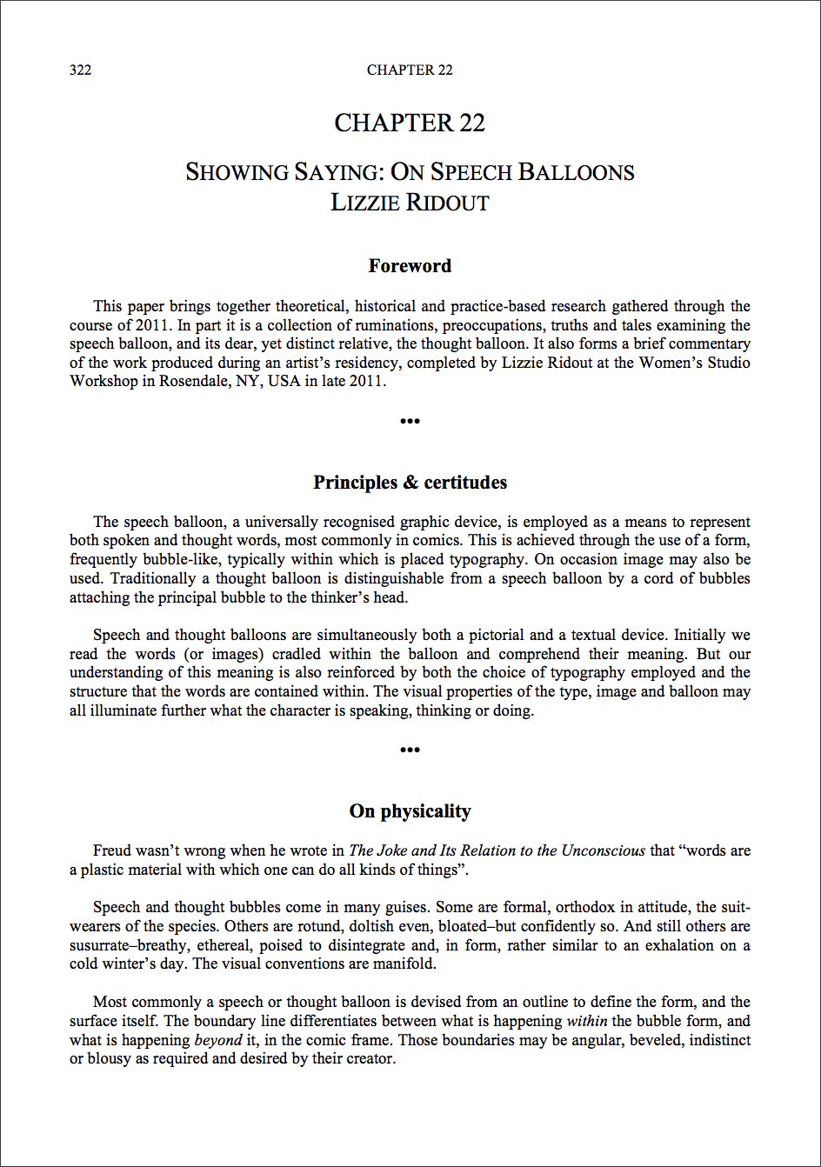
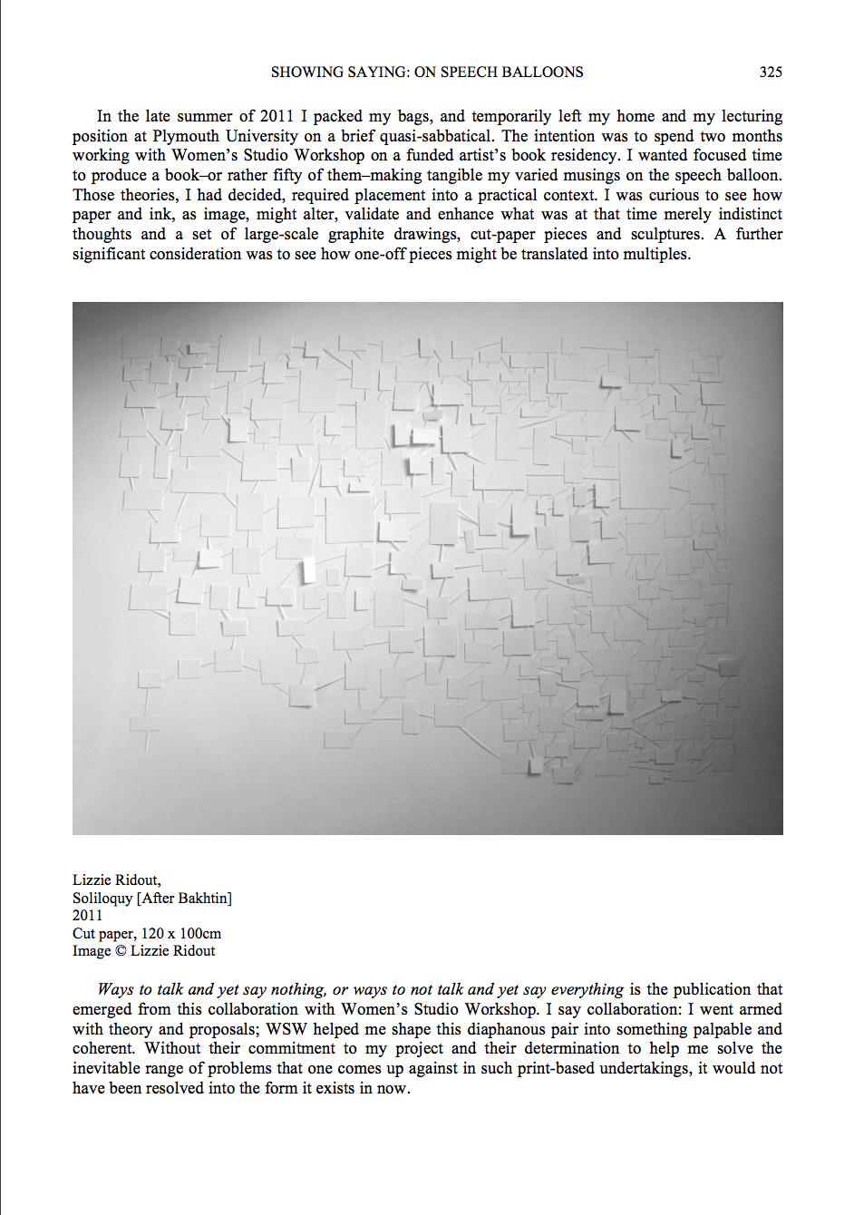
Visual Record of Output: Article
’Showing Saying: On Speech Balloons’ Chapter by Lizzie Ridout published in ’Semiotics & Visual Communication: Concepts & Practices’. Published by Cambridge Scholars, UK, 2014. ISBN 978-1-4438-5468-9

Slide 6
Previous Supporting Work
This article consolidates research presented in a number of articles/conferences/residencies/publications.
It was delivered as:
– Originally, an article called ‘The Art of the Speech Balloon’ in ‘Varoom’ (Issue 16, Autumn 2011, ISSN 1750-483X).
– A paper at the ‘First International Conference of Semiotics & Visual Communication’, Cyprus University of Technology, Limassol, 2011.
– A funded Book Arts residency, Women’s Studio Workshop (WSW), Rosendale, NY, USA, 2011/2012, plus publication thereof: ‘Ways to Talk and Yet Say Nothing, or Ways to not Talk and Yet Say Everything’ , ISBN 1-893125-79-3.
– An independent, distinct article called ‘An Essay Concerning the Architecture of Conversation’ in ‘Message: Mapping Eclecticism Through Practice’ (published by University of Plymouth Press, Plymouth, UK, 2013, ISBN: 978-1-84102-347-2). The article mapped a critical dialogue concerning visual spatiality and temporality in speech and dialogue. The article’s design reflected the time-based, fleeting, yet physical nature of utterances.

Slide 7
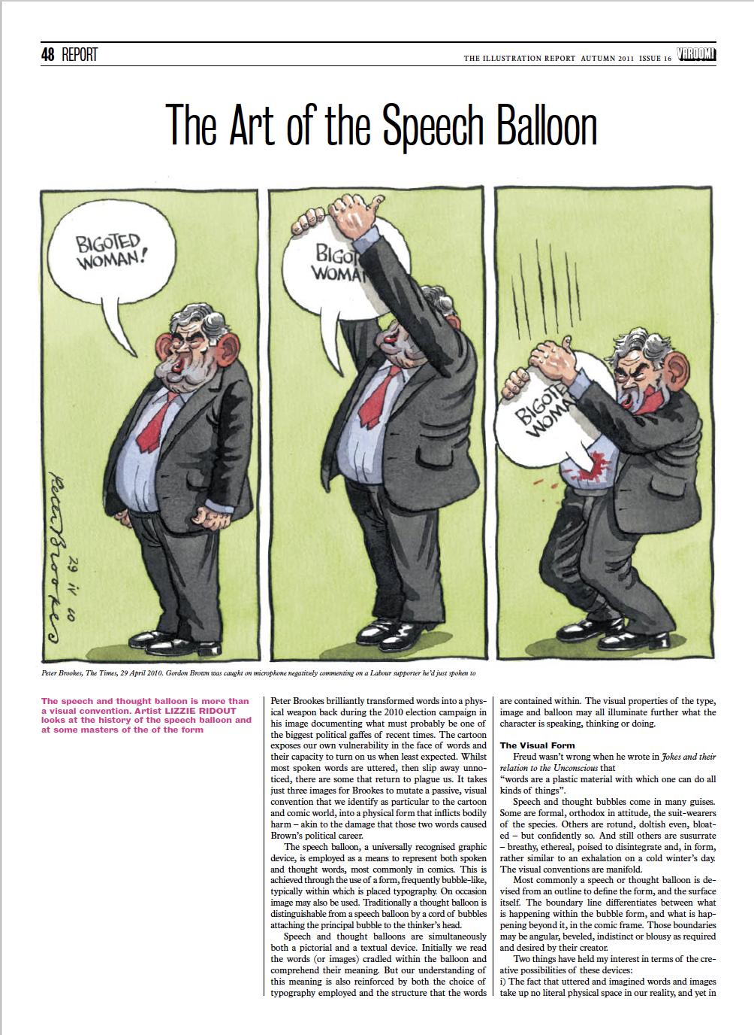
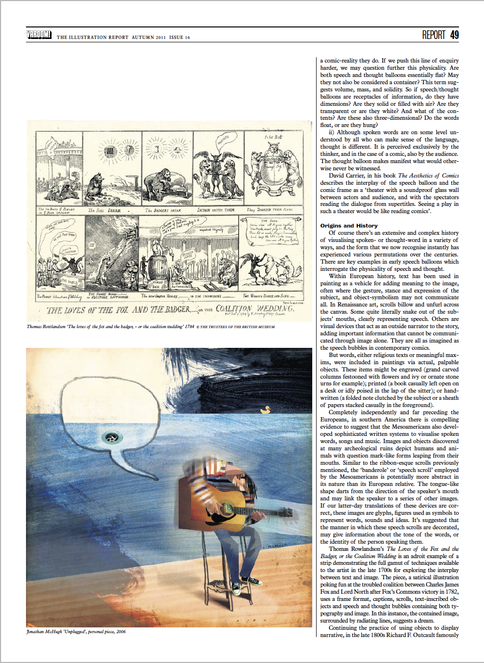
Previous Supporting Work
‘The Art of the Speech Balloon’. Article by Lizzie Ridout, published in Varoom, Issue 16, Autumn 2011, ISSN 1750-483X

Slide 8
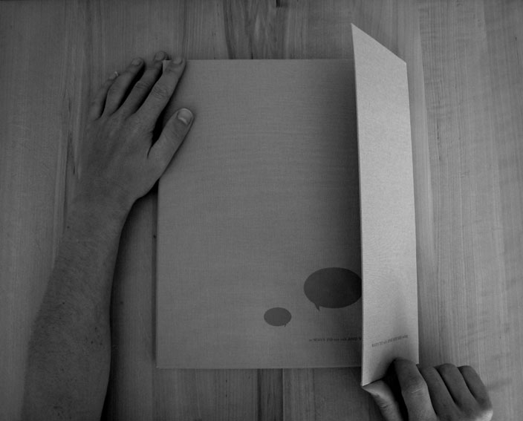
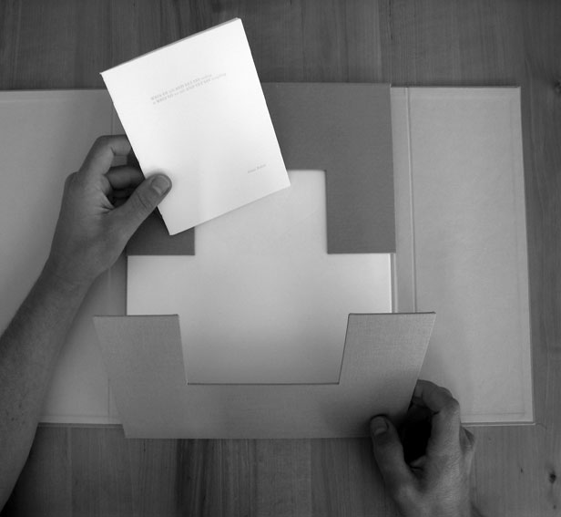
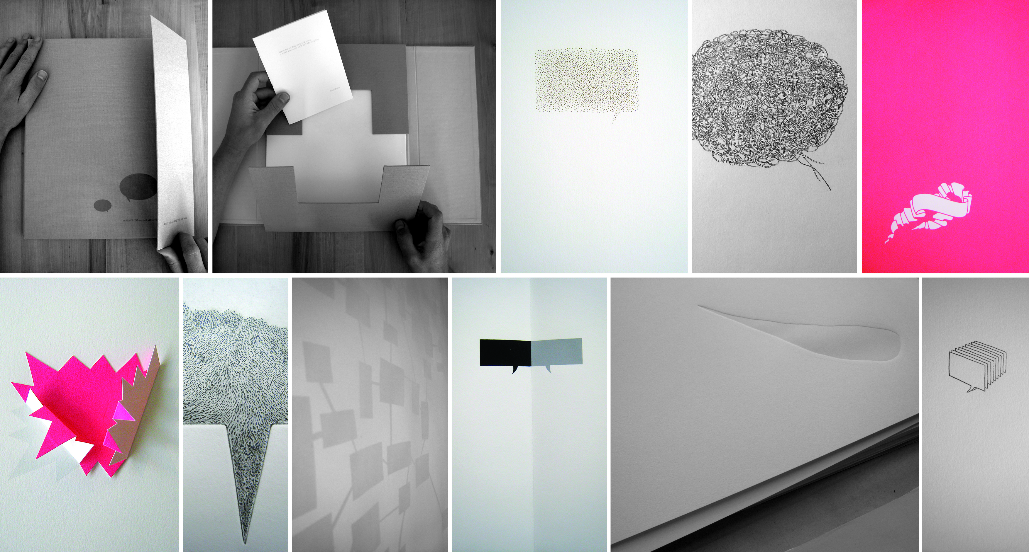
Previous Supporting Work
Book Arts residency at Women’s Studio Workshop (WSW), Rosendale, NY, USA, 2011/2012, plus publication thereof: ‘Ways to Talk and Yet Say Nothing, or Ways to not Talk and Yet Say Everything’ , published by WSW, Rosendale NY, 2011, ISBN 1-893125-79-3.
Original WSW residency funded by New York State Council on the Arts, National Endowment for the Arts, and the Andy Warhol Foundation for the Visual Arts. WSW is the largest producer of handmade books in the US.
The WSW publication produced during the residency at WSW is held in the following repositories: Yale University, Rochester Institute of Technology, Virginia Commonwealth University, Indiana University Bloomington, University of Delaware, Vassar College, Lafayette College, Library of Congress, New York Public Library, Reed College.
Images: ‘Ways to Talk and Yet Say Nothing, or Ways to not Talk and Yet Say Everything’ artist’s book.

Slide 9
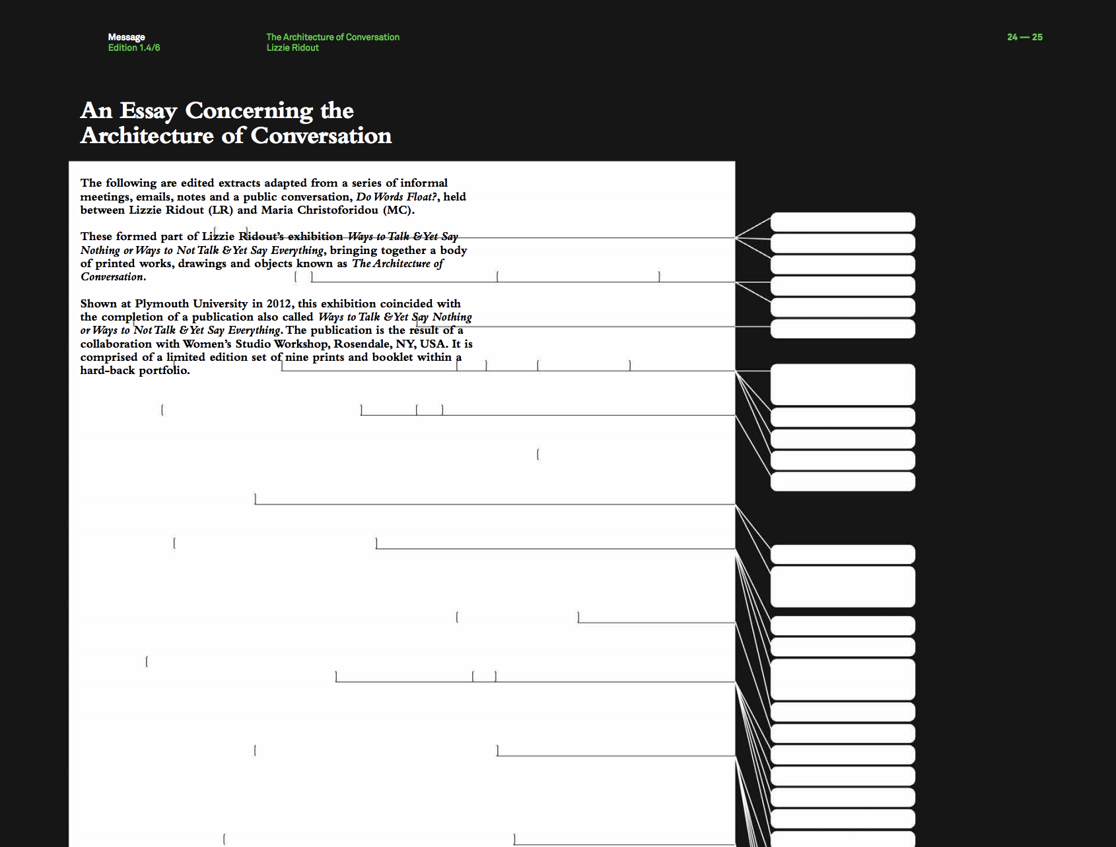
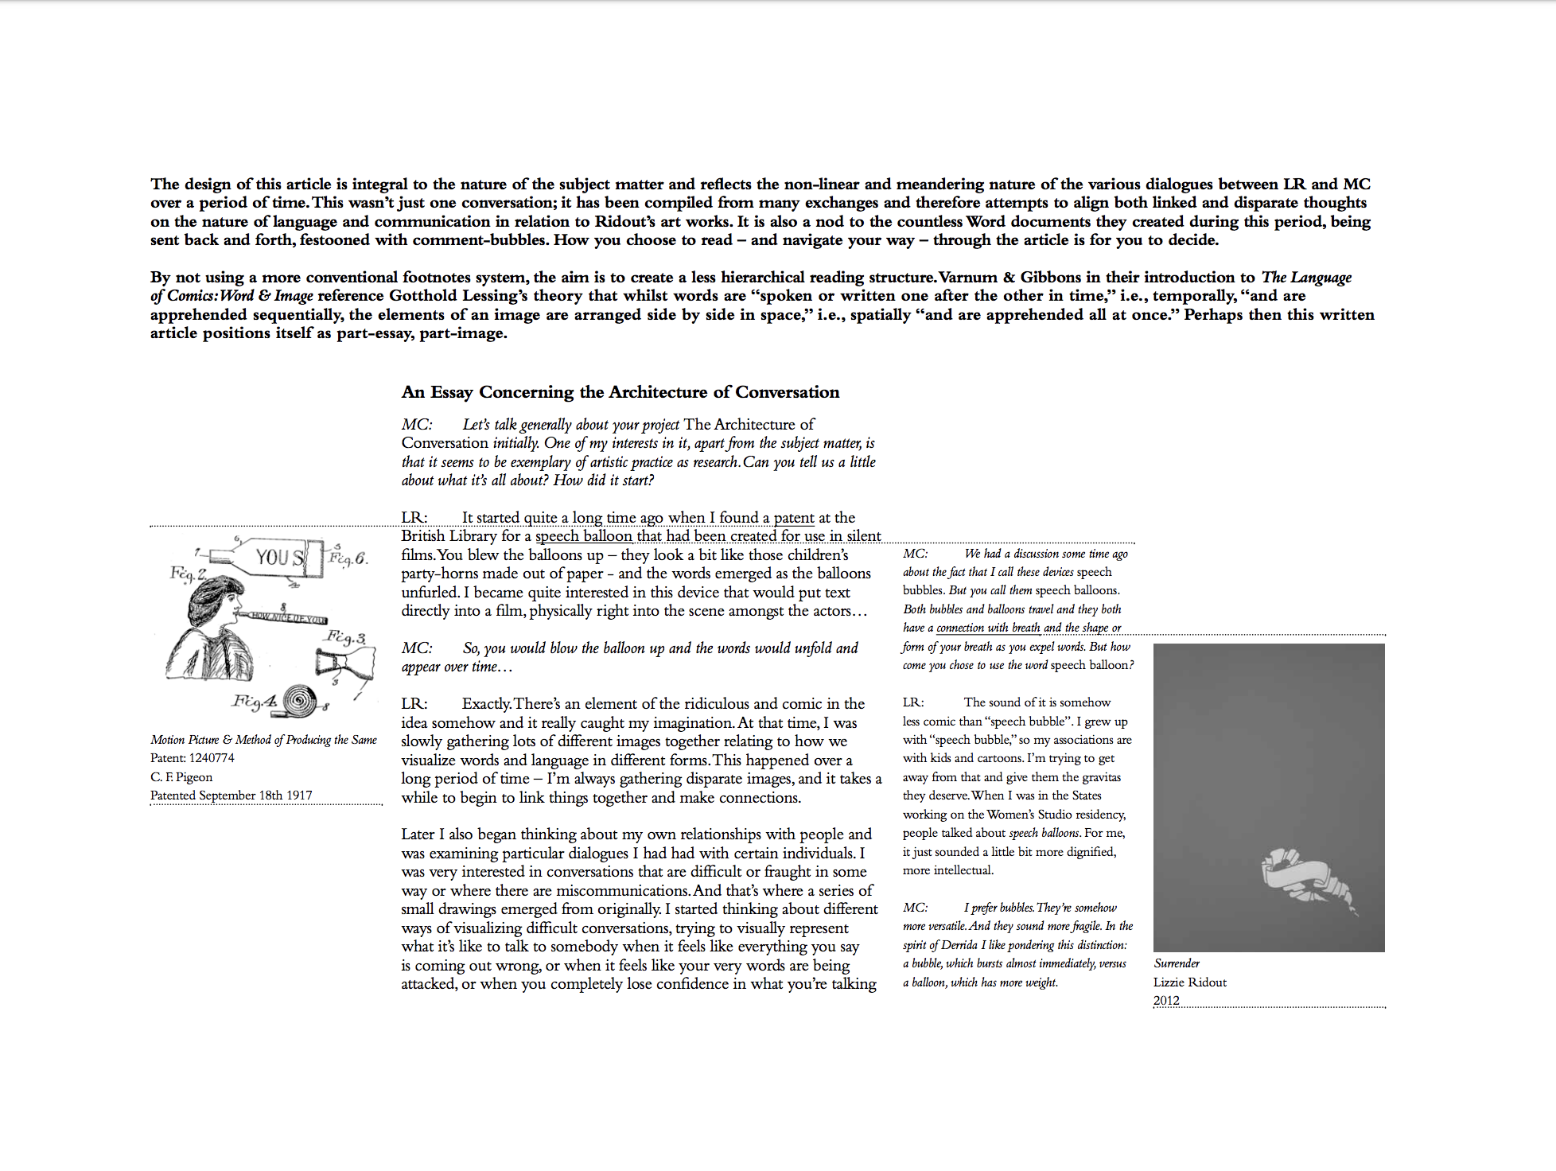
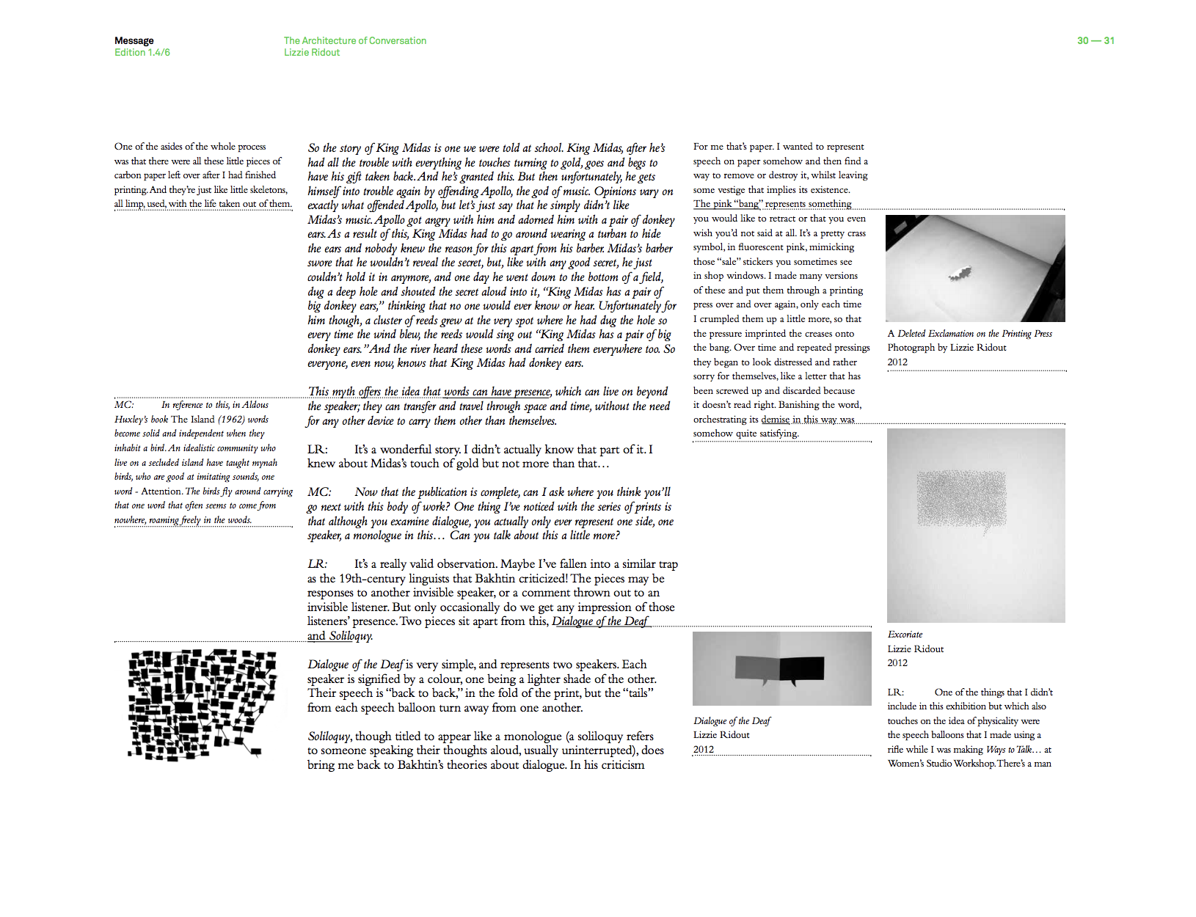
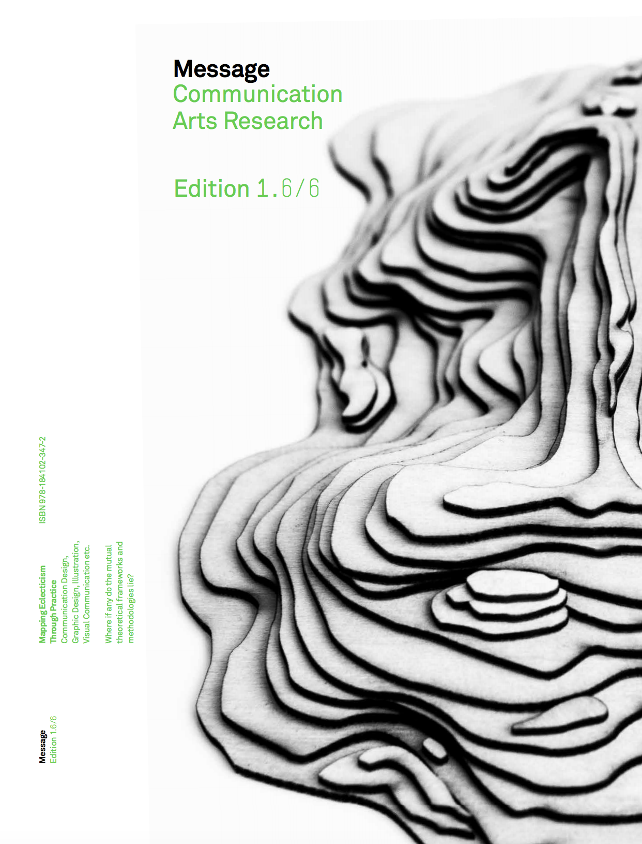
Previous Supporting Work
‘An Essay Concerning the Architecture of Conversation’. Peer reviewed article by Lizzie Ridout, in ’Message: Mapping Eclecticism Through Practice’, published by University of Plymouth Press, Plymouth, UK, 2013, ISBN: 978-1-84102-347-2.

Slide 10
Links to Media Record of Output
‘Showing Saying: On Speech Balloons’: http://www.lizzieridout.com/images/Showing_Saying_ICSVC_Paper_Lizzie_Ridout.pdf
‘Ways to Talk and Yet Say Nothing, or Ways to not Talk and Yet Say Everything’ published by WSW, NY, USA: https://wsworkshop.org/artists/lizzie-ridout/
Documentation of WSW residency: https://www.lizzieridout.com/wsw.html
Film about WSW with Lizzie: https://vimeo.com/35700449
‘An Essay Concerning the Architecture of Conversation’ in ’Message: Mapping Eclecticism Through Practice’, : https://www.amazon.co.uk/Message-Communication-Arts-Research-Eclecticism-ebook/dp/B012IUP8GA/ref=sr_1_1?keywords=%E2%80%99Message%3A+Mapping+Eclecticism+Through+Practice&qid=1582810431&sr=8-1

