Slide 1
Racing Green: How MoTORSPORT SCIENCE CAN SAVE THE WORLD
Dr Kit CHAPMAN FalMOUTH UNIVERSITY
@ChemistryKit

Slide 2
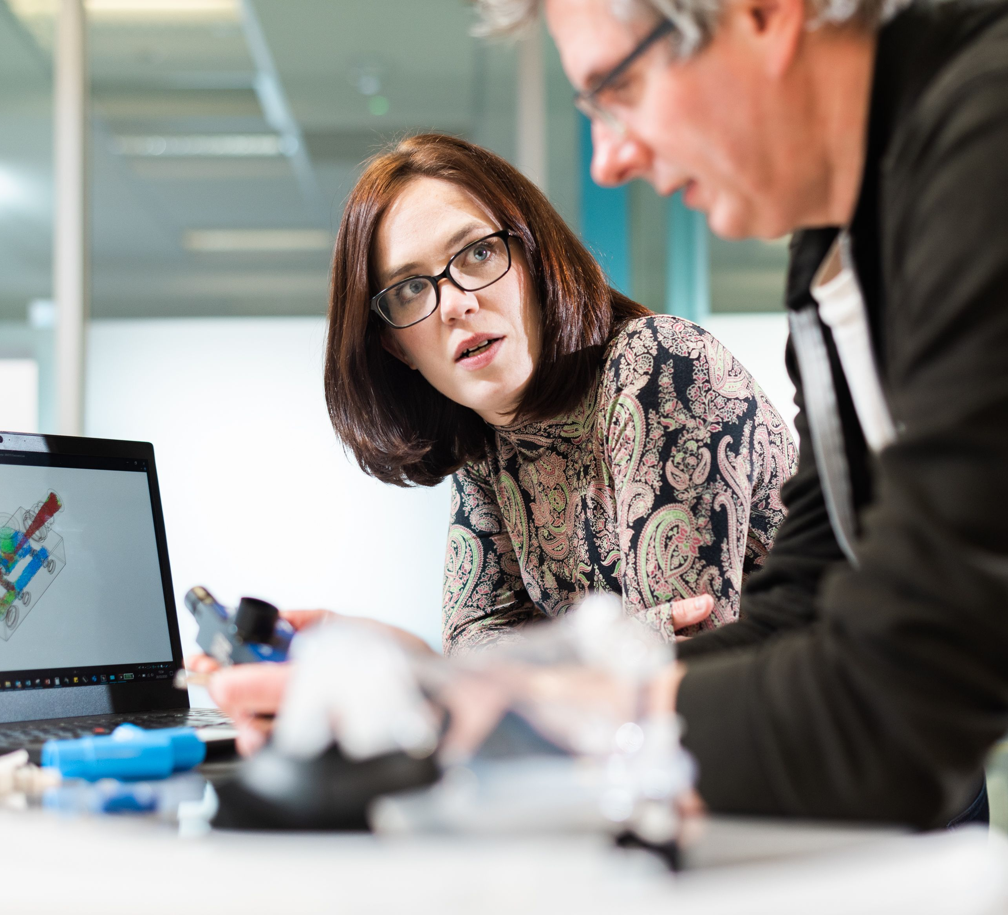
“THE FULL MIGHT OF WHAT WE CAN DO”
17 March 2020
UCL involved in UK ventilator challenge
Called Mercedes-AMG HPP

Slide 3
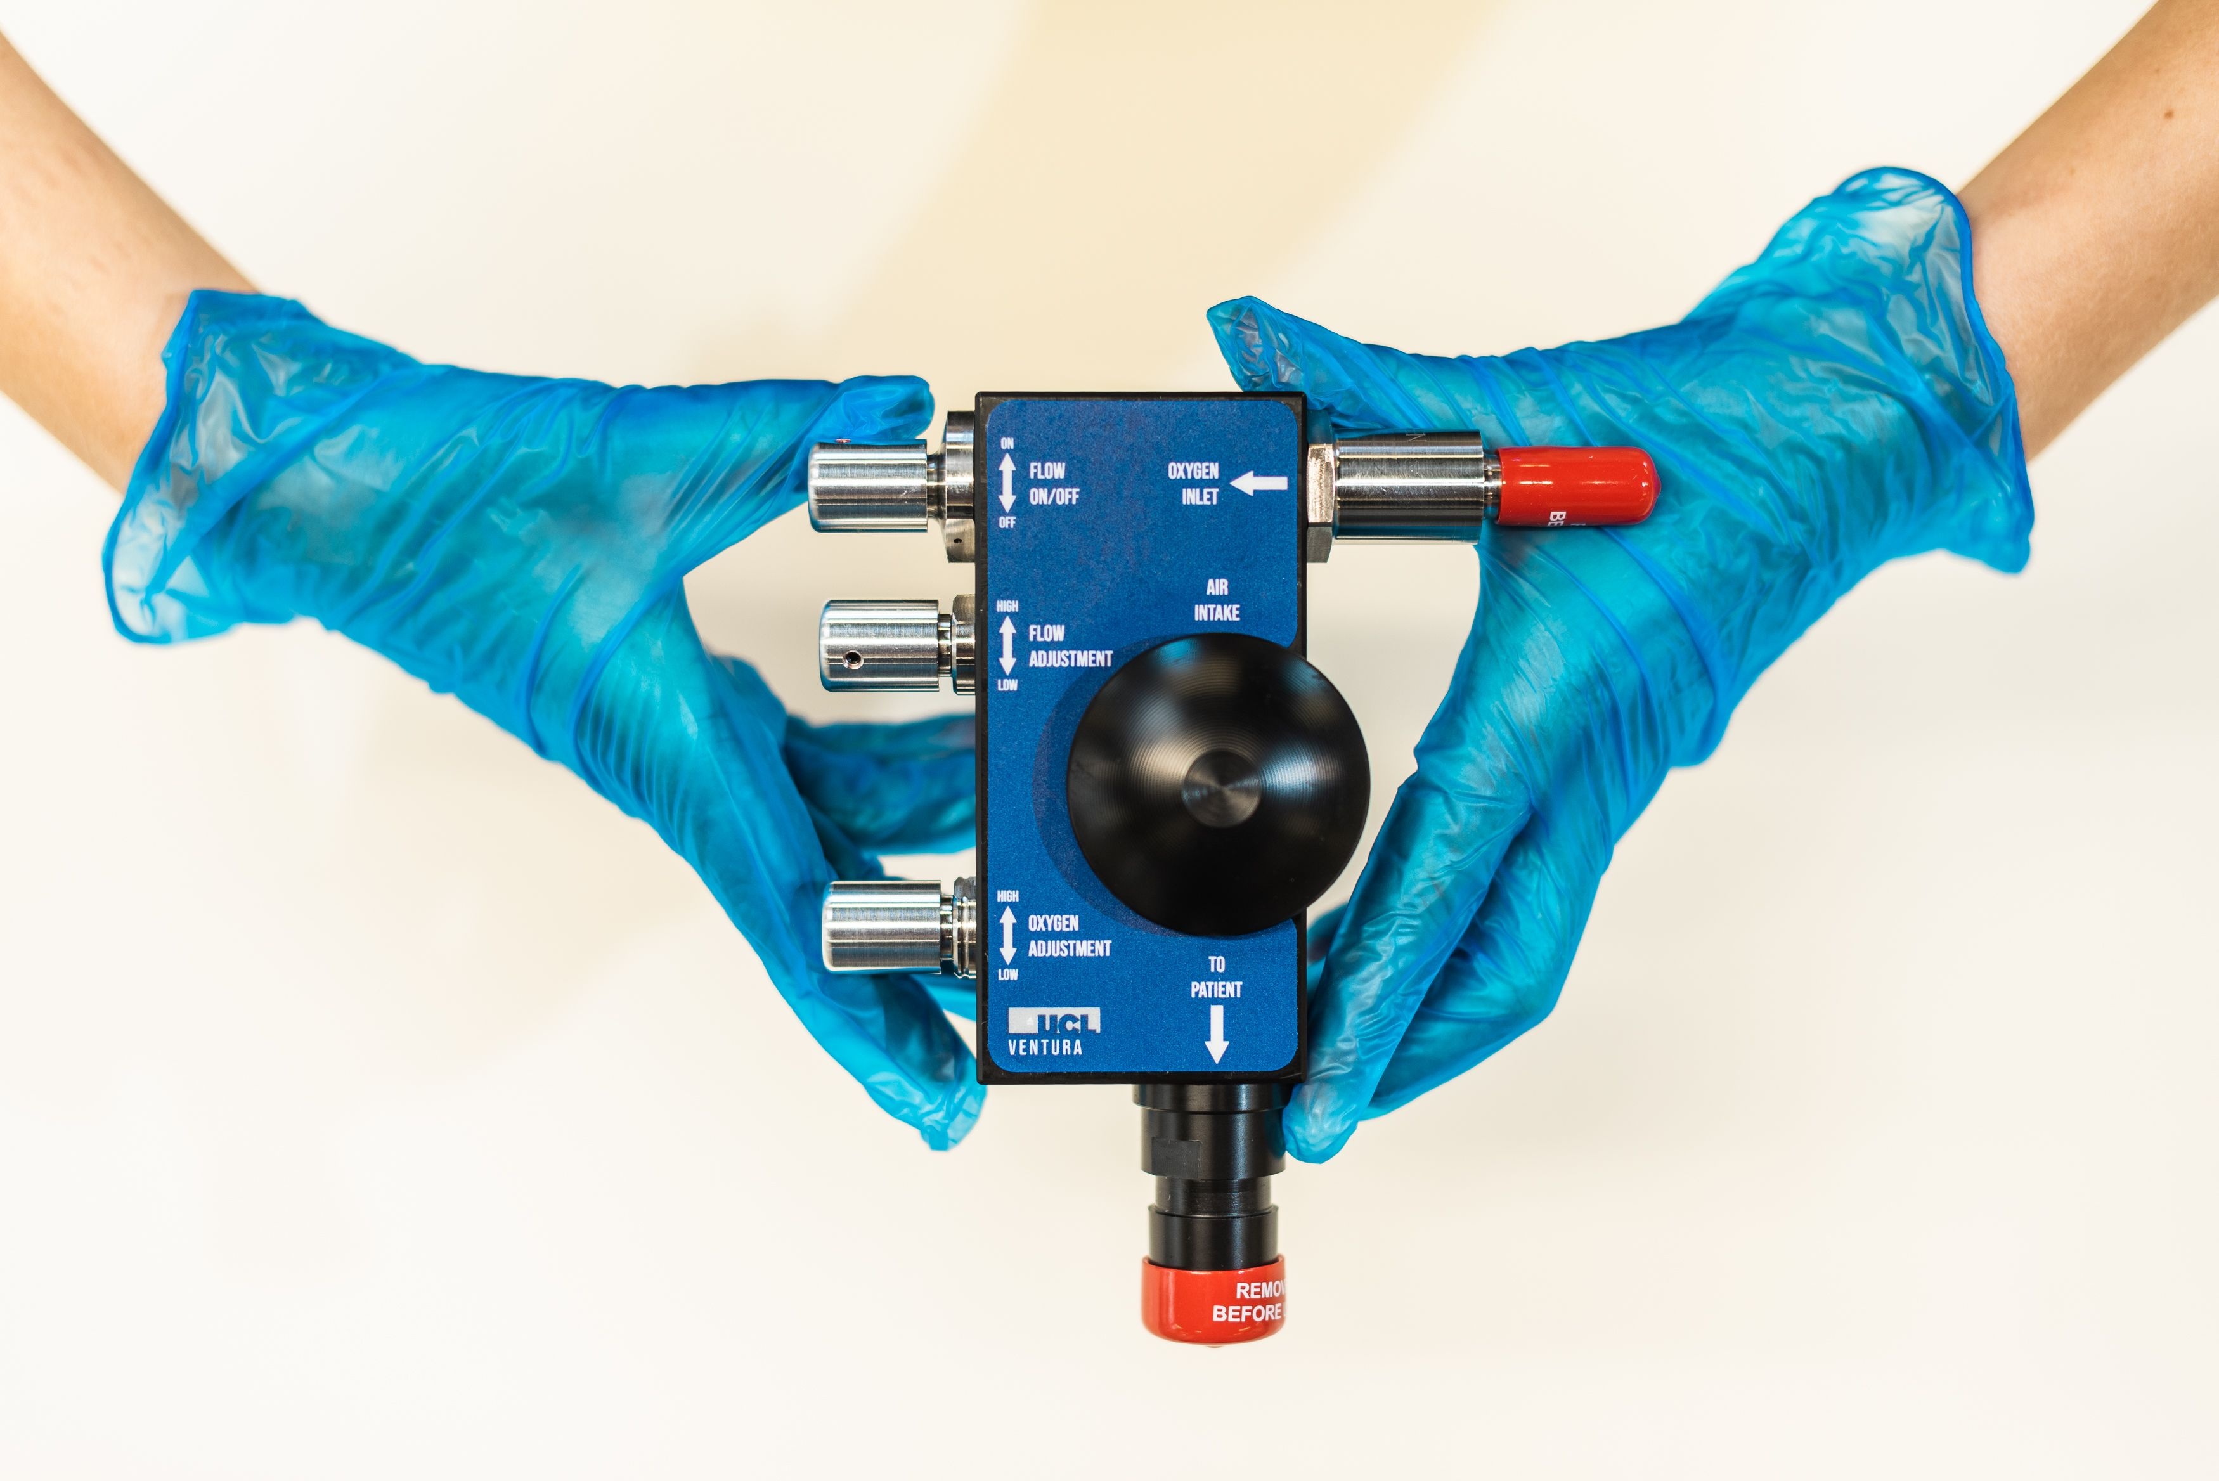

Slide 4
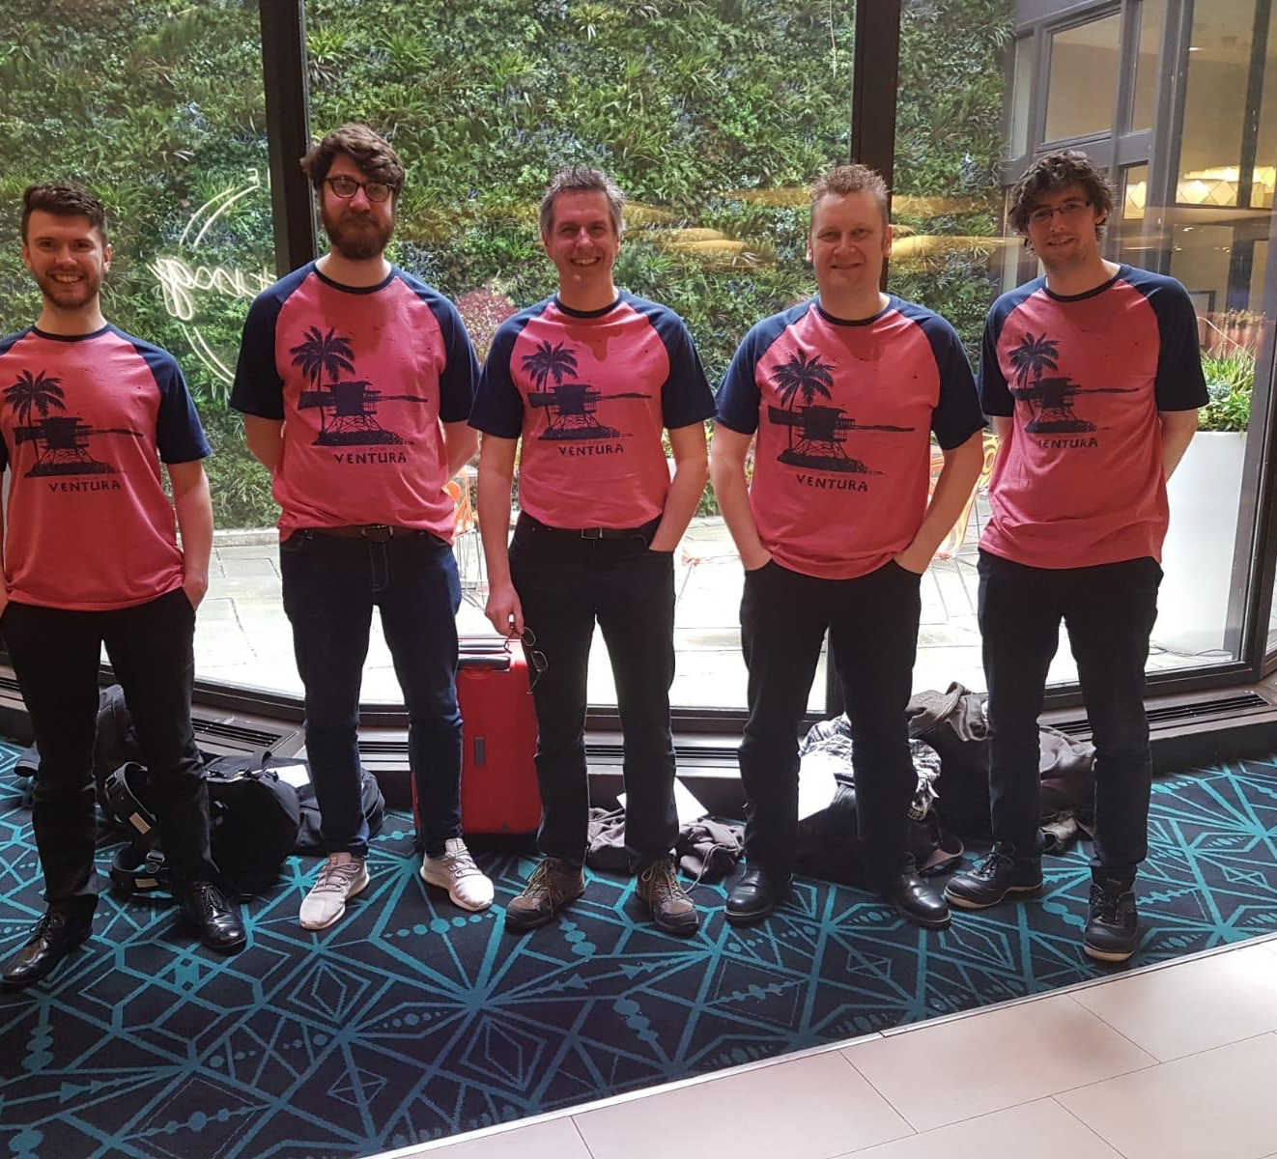
+1 day: prototype
+3 days: in hospitals
+12 days: two devices approved
+30 days: 10,000 CPAP machines built and in NHS hospitals

Slide 5
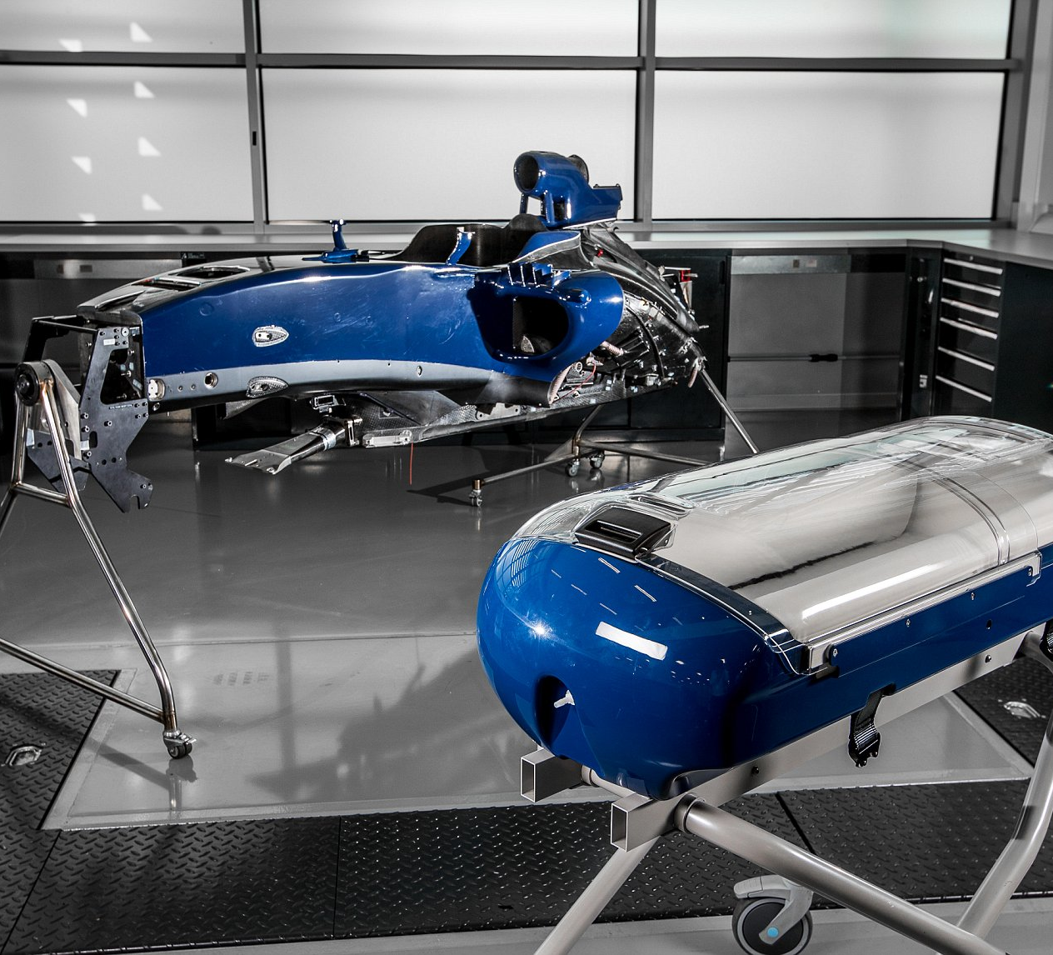
Great Ormond Street paediatrics ‘pitstops’
Birmingham Children’s Hospital cardiac monitors
Williams BabyPod
Ventilator Challenge

Slide 6
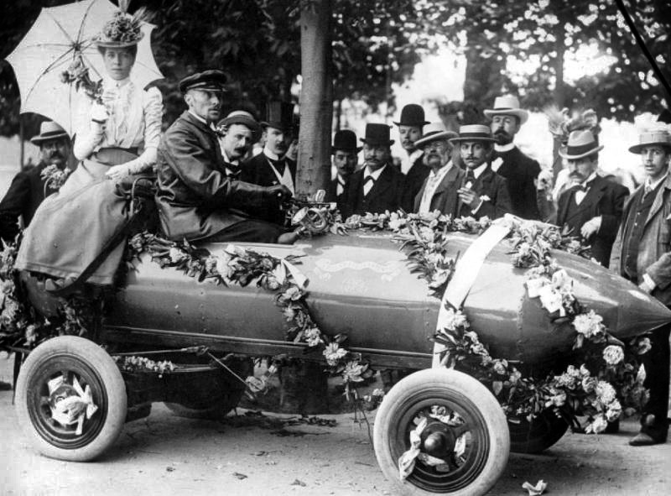
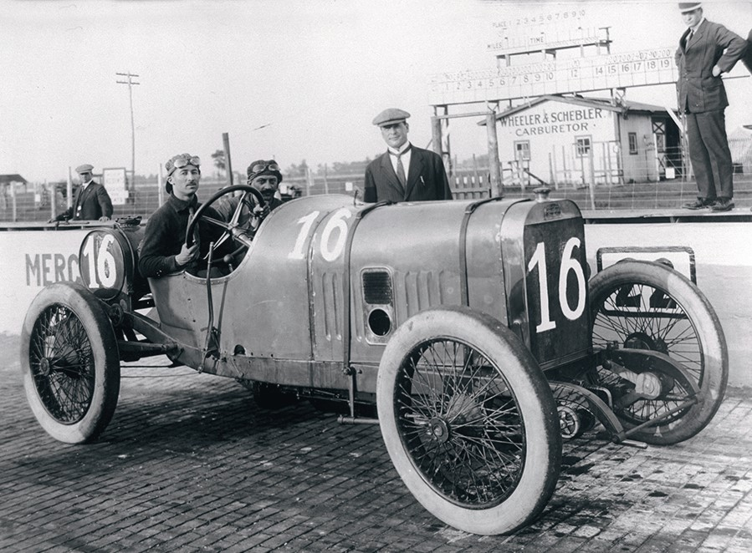
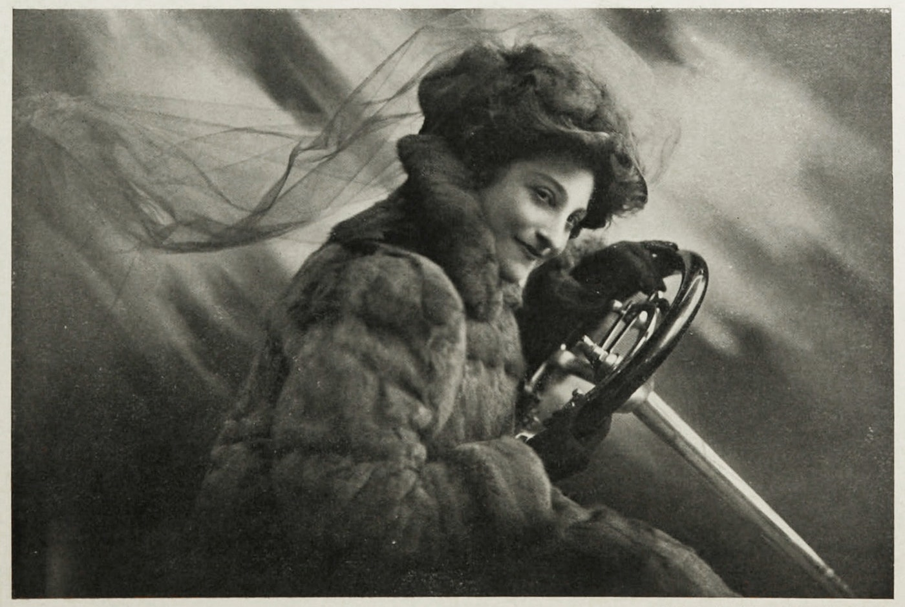
RACE INNOVATIONS HAVE CHANGED OUR WORLD

Slide 7
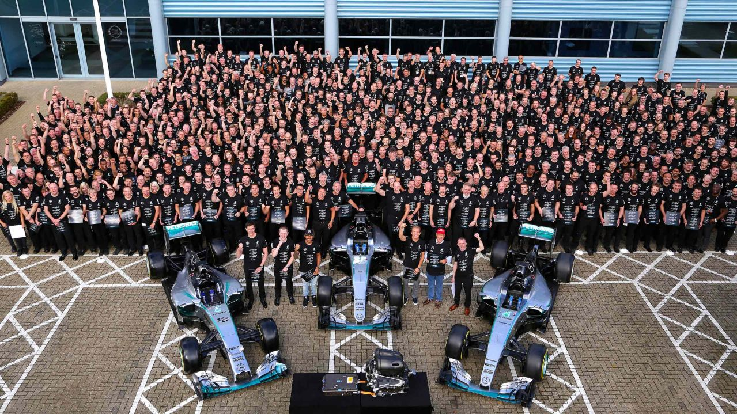
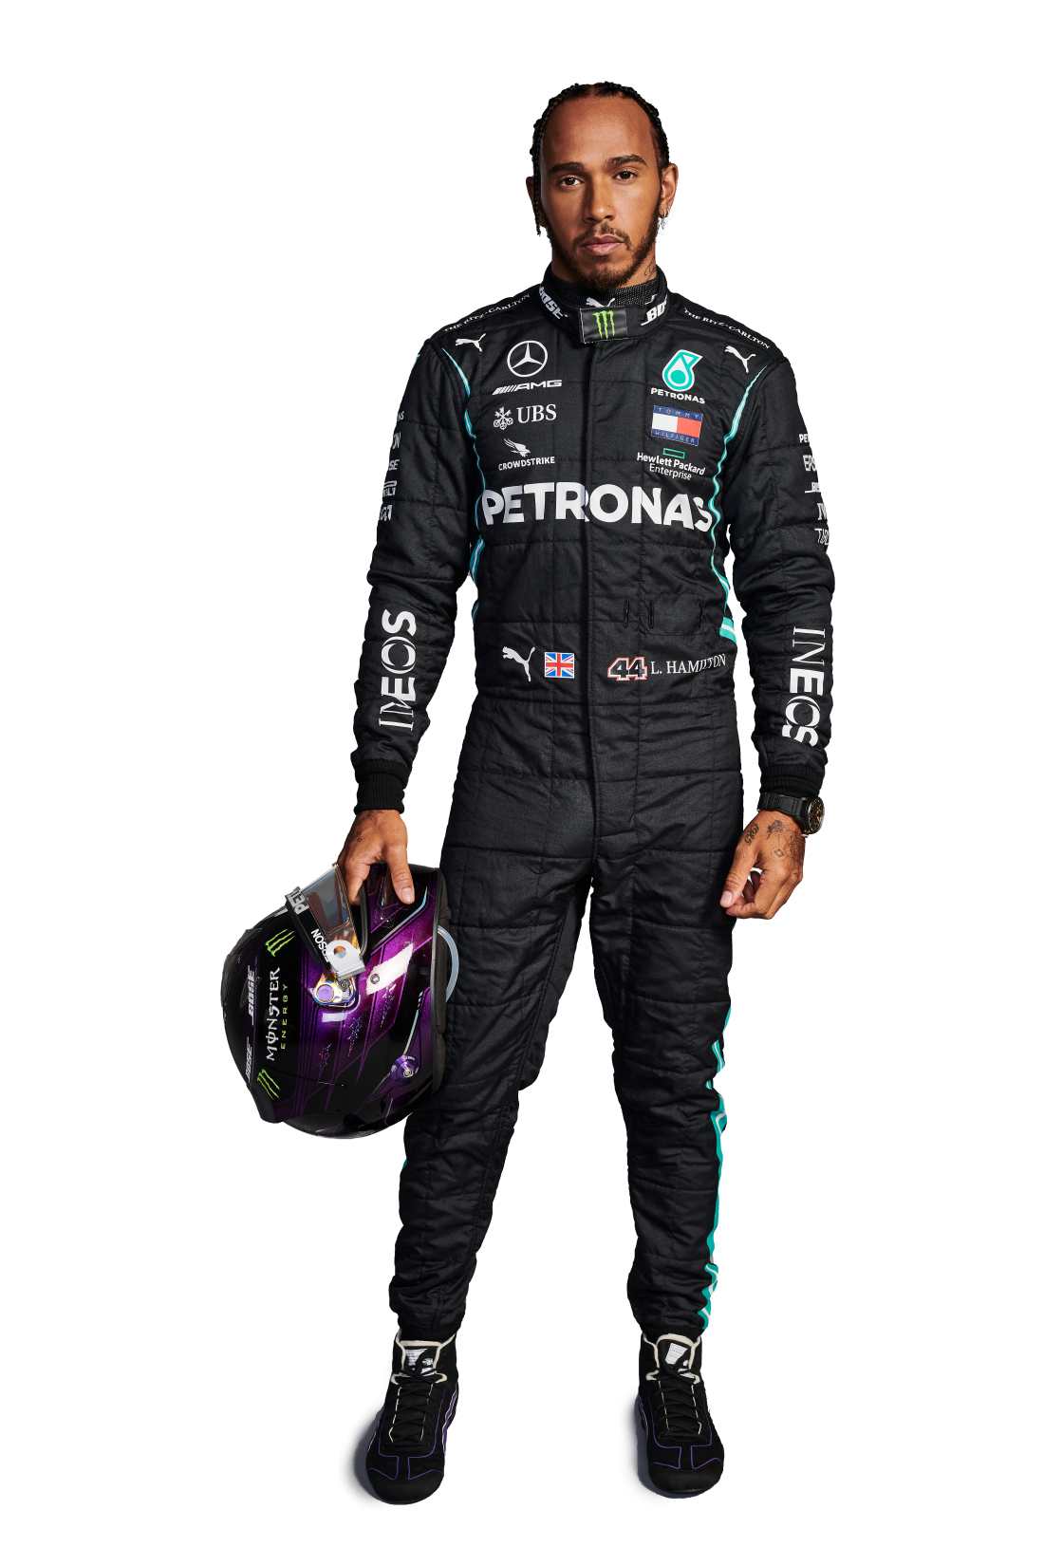
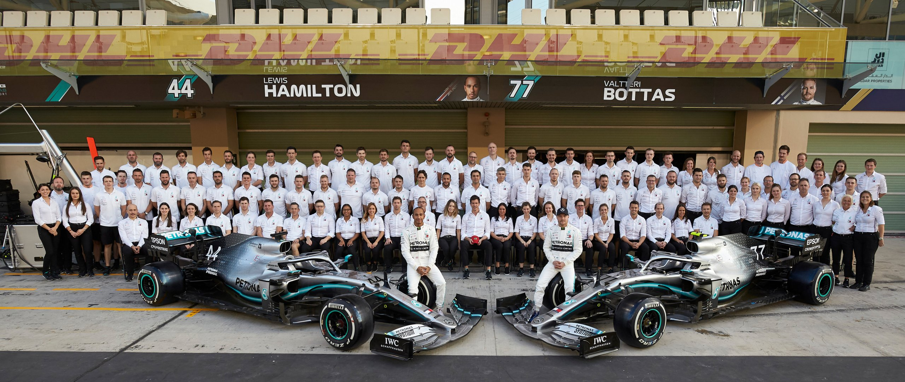
Anatomy of a formula one car
Body
Aerodynamics
Tyres
Engine

Slide 8
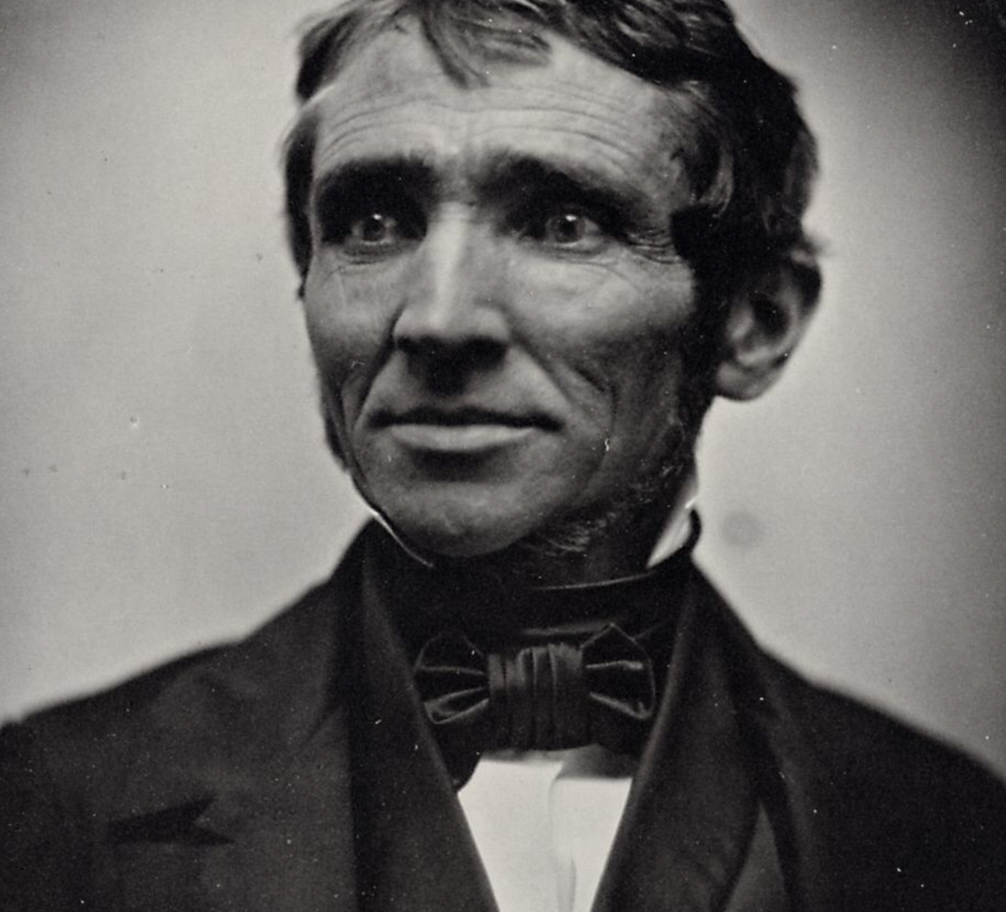
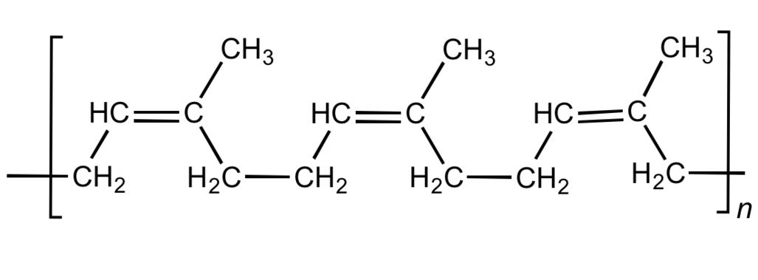
Tyres for fun and no profit at all
Cis-1-4-polyisoprene
Charles Goodyear discovers vulcanization
Sulfur bridges between strands

Slide 9
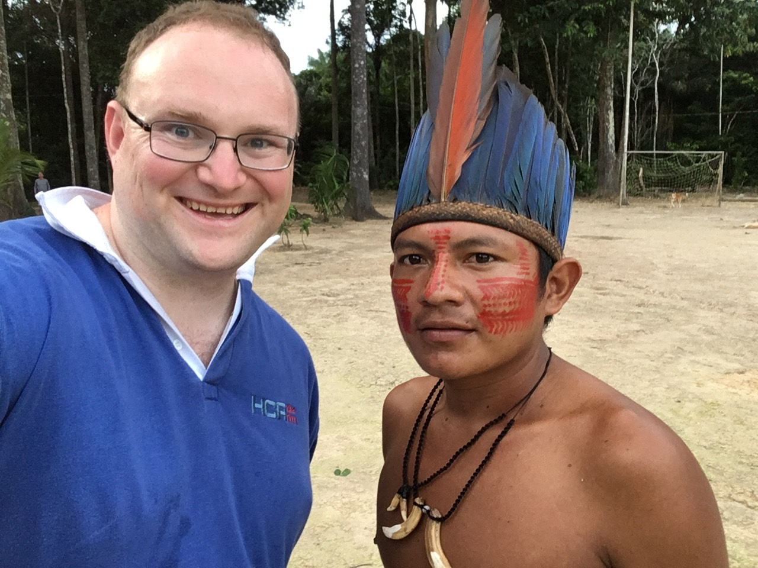
WHERE DO TYRES COME FROM?
Originally Brazil
Millions died for it
Today Thailand
Tomorrow…

Slide 10
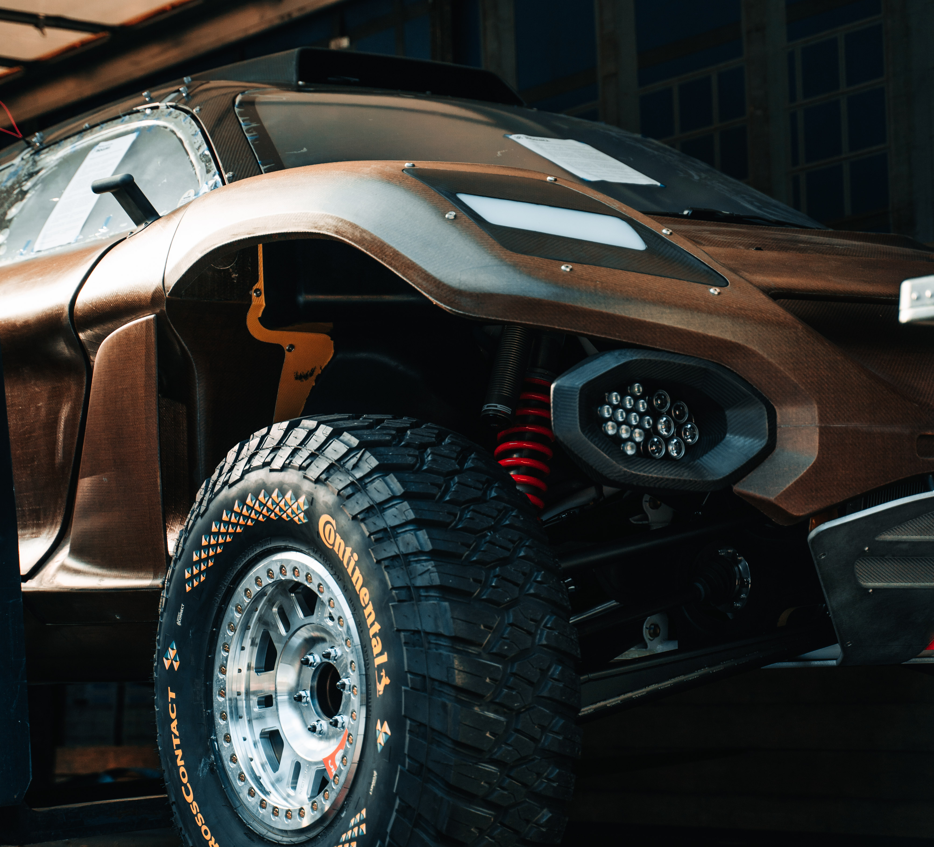
TYRES MADE FROM DANDELIONS!
Taraxacum kok-saghyz
Also the guayule shrub in North America
Still both have awful histories…

Slide 11
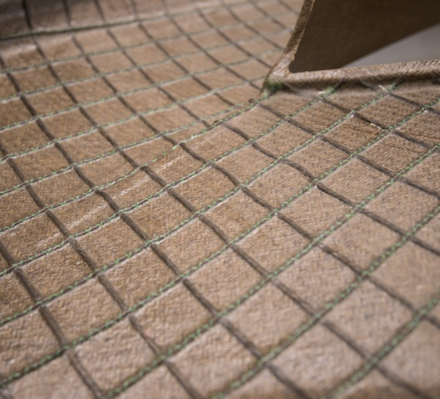
BODYWORK MADE FROM LINEN!
Already in use in Formula One
But we are going to have something even better…

Slide 12
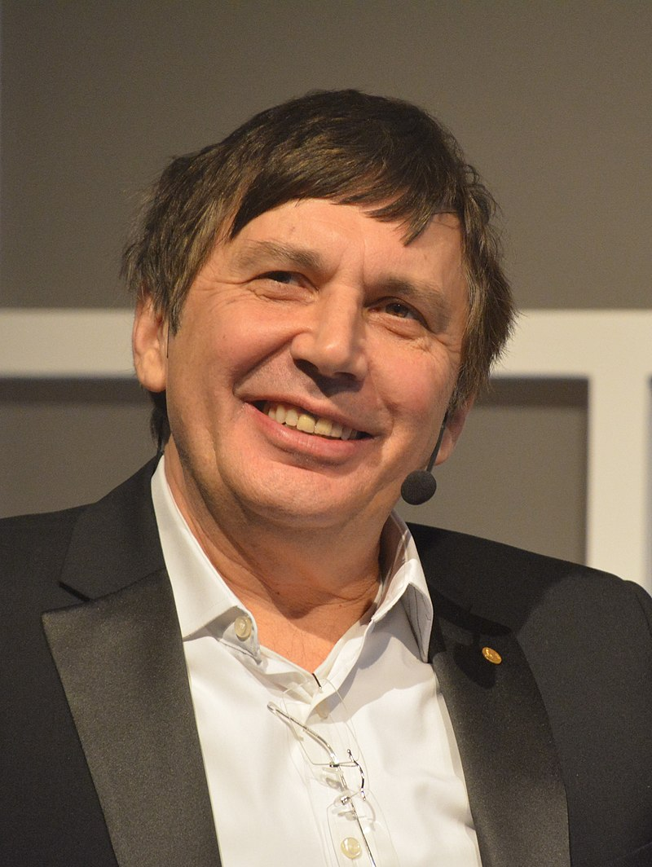
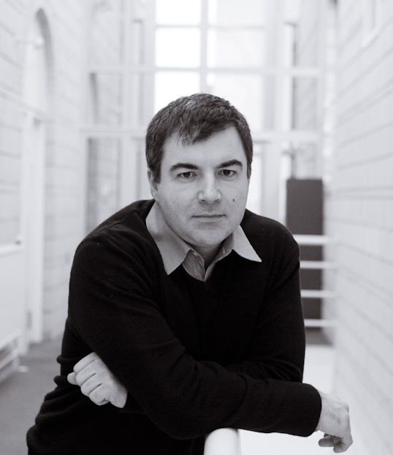
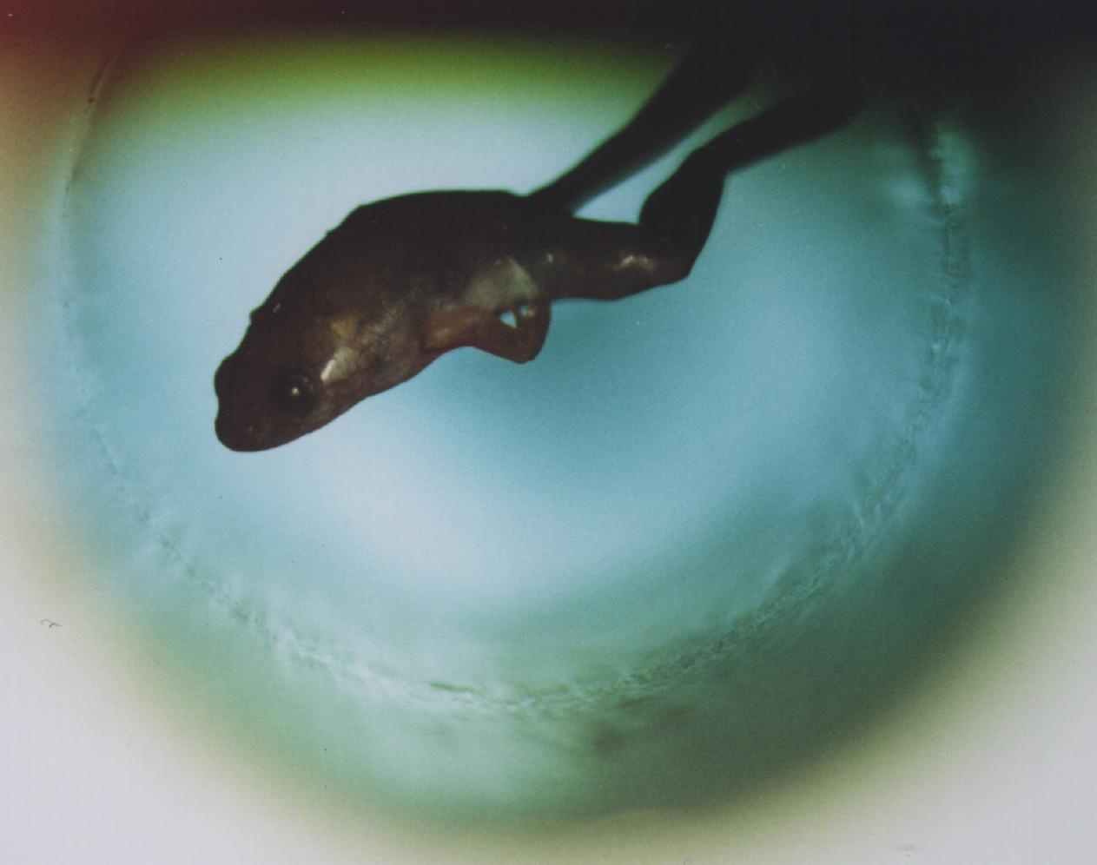
TWO MEN AND A FROG
Andre Geim
Konstantin Novoselov

Slide 13
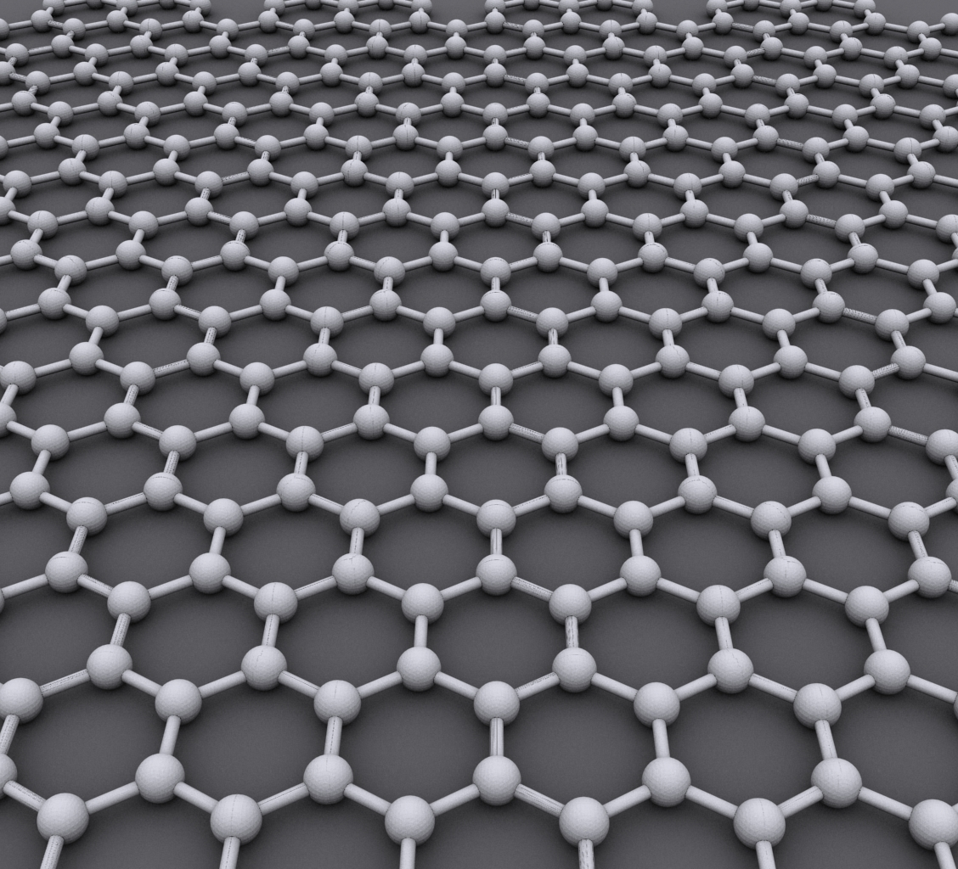
THE ULTIMATE FUTURE MATERIAL
Each atom connected by a σ-bond
Large thermal and electrical conductivity, strong, can be shaped

Slide 14
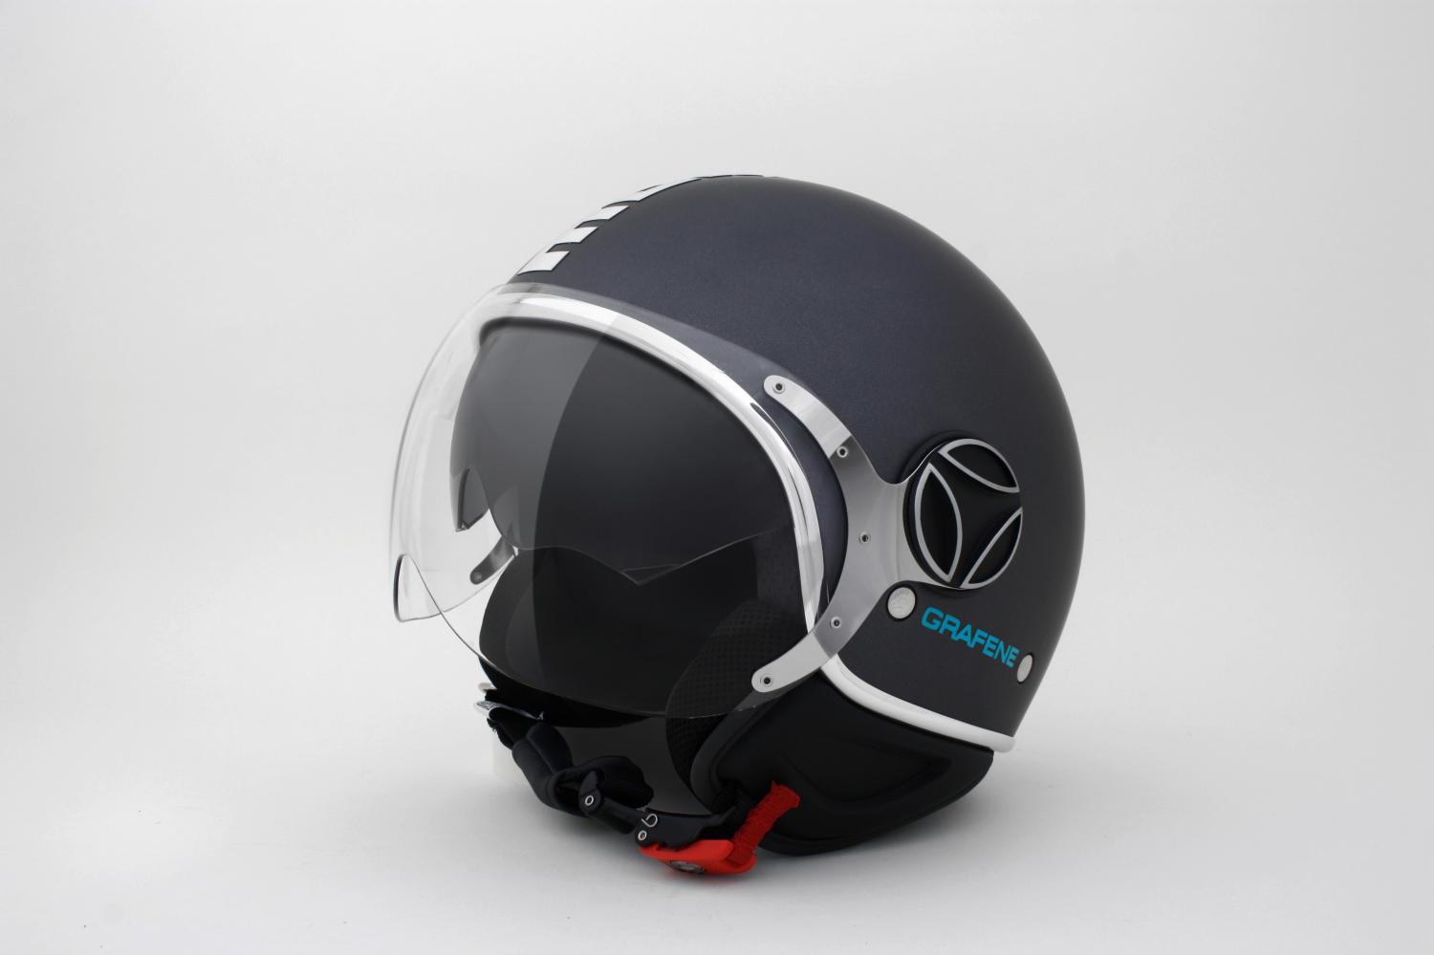
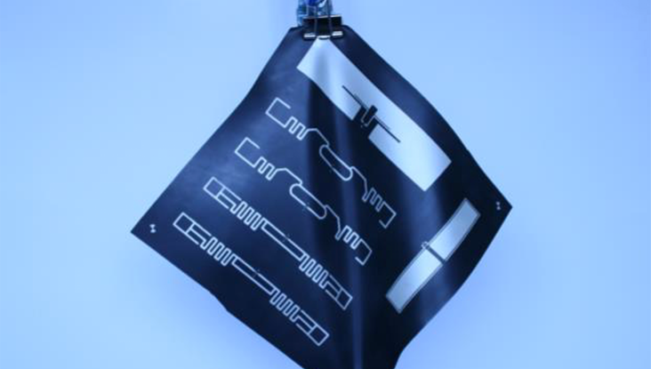
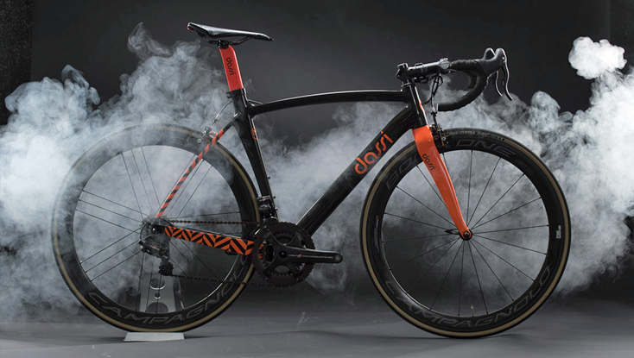
JUST A FEW GRAPHENE IDEAS…

Slide 15
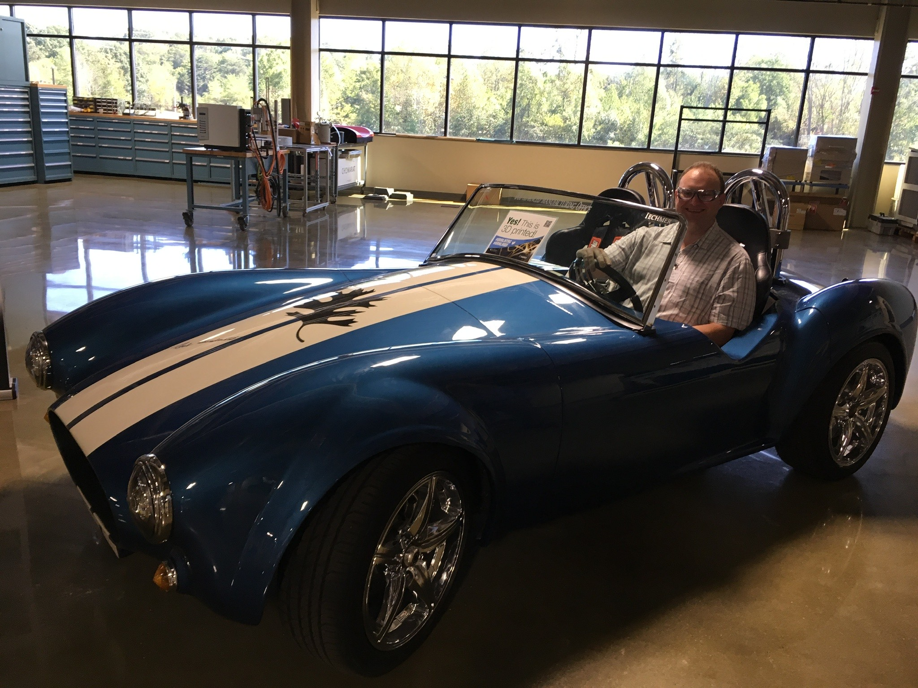

Slide 16
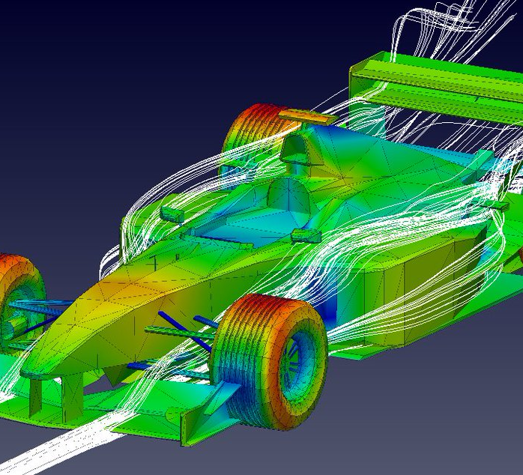
How do Aerodynamics help me?
F1 cars could drive upside down
What if we could use their aero packages elsewhere?

Slide 17
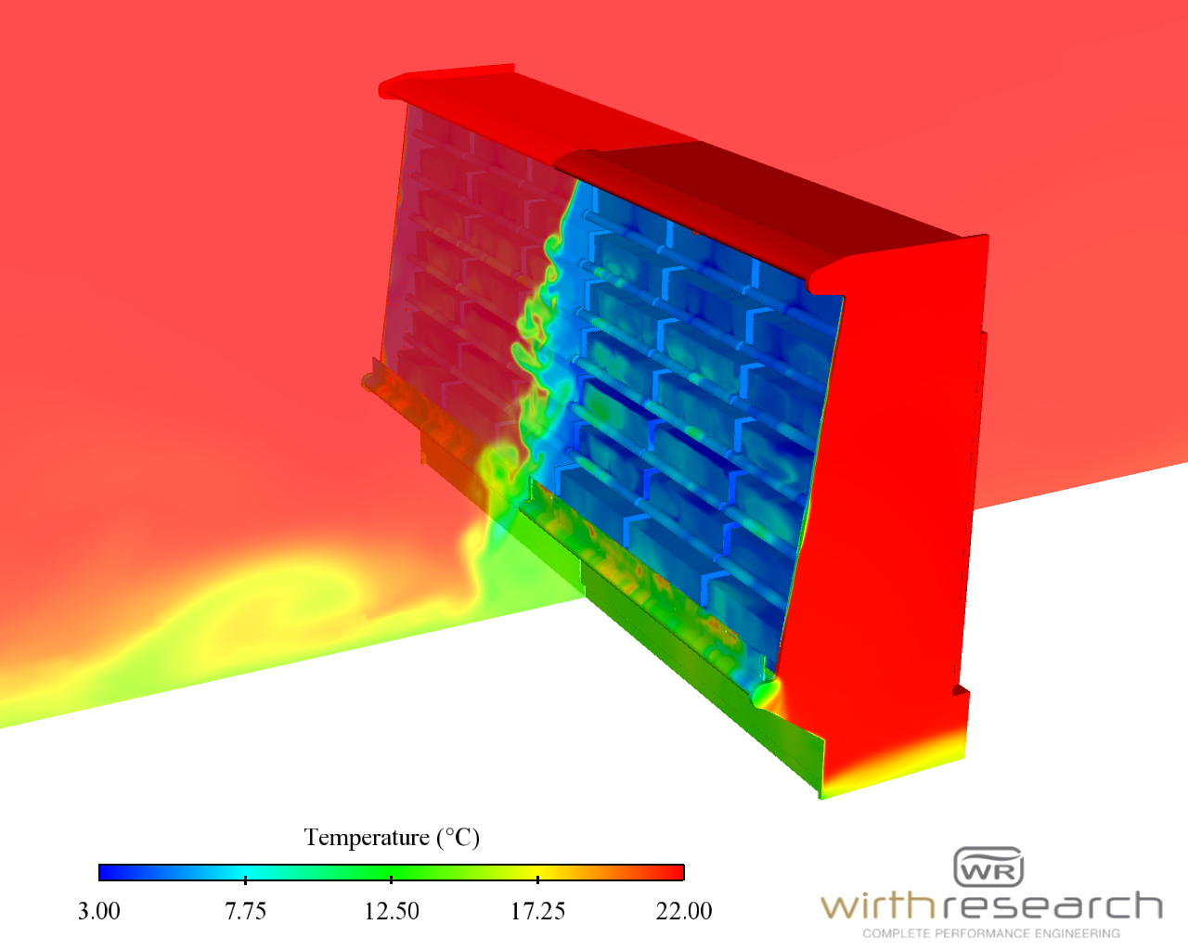
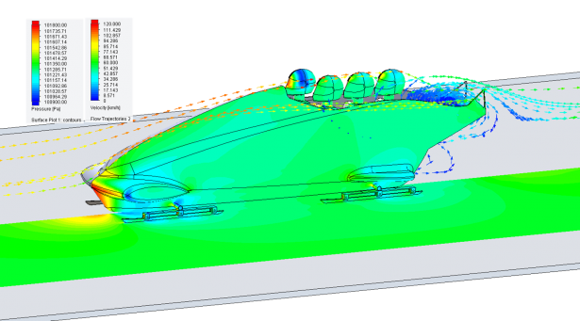
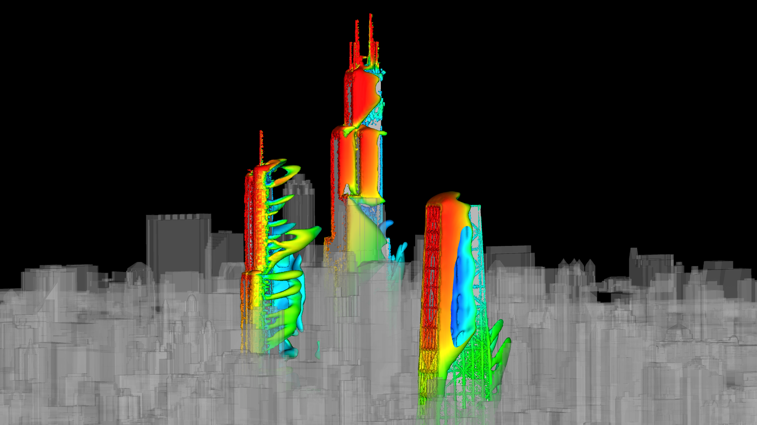
The world of CFD

Slide 18
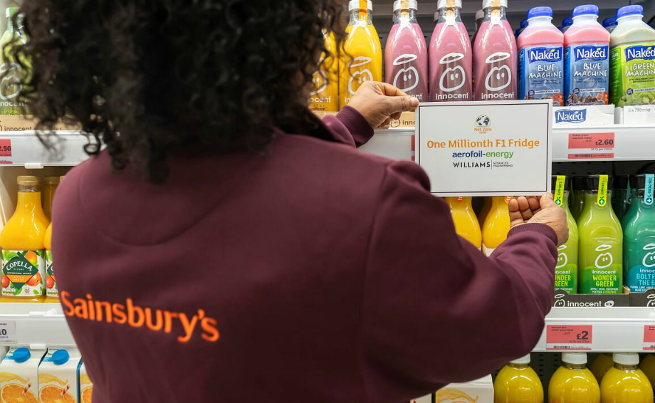

Slide 19
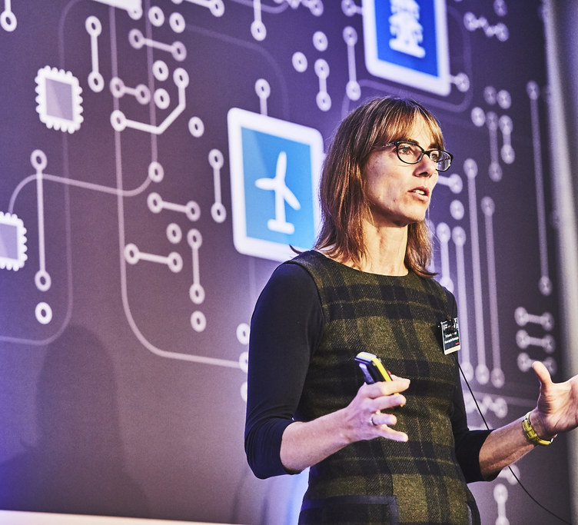
Why not model other things?
Caroline Hargrove, formerly of McLaren
Now looking at the concept of digital twins

Slide 20
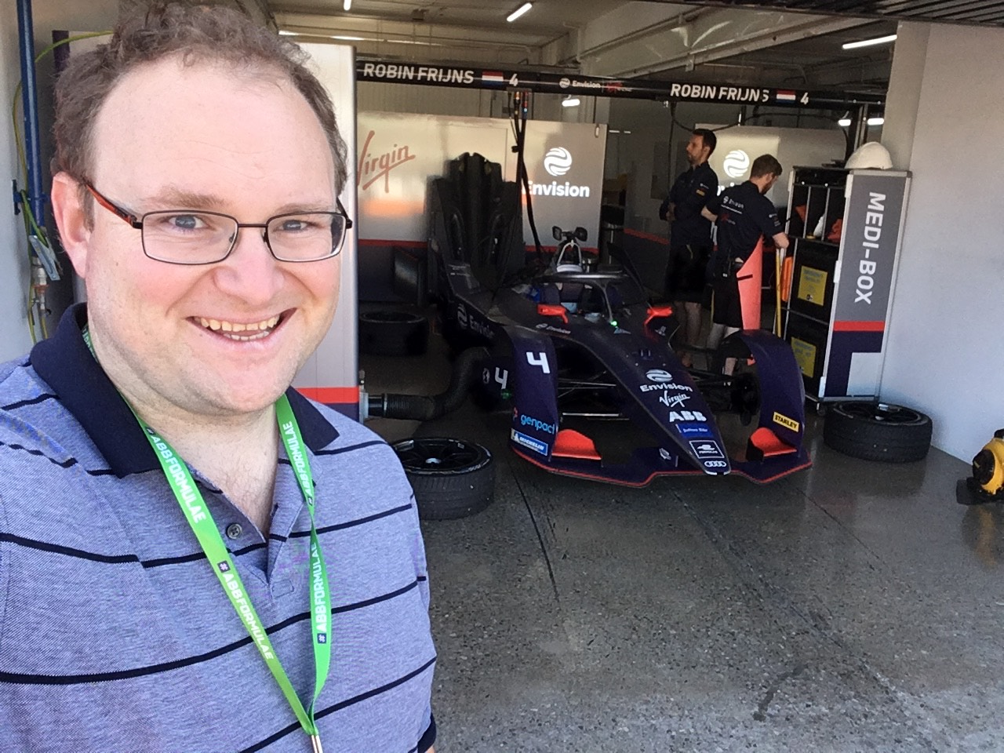
What will power the future?
Li-ion batteries already used, 350kw engine (470bph)
40% of energy used in the race is recovered through braking

Slide 21
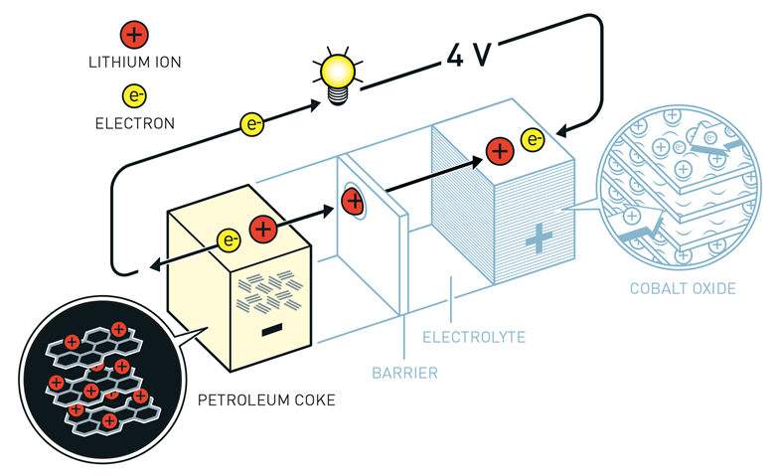

Slide 22
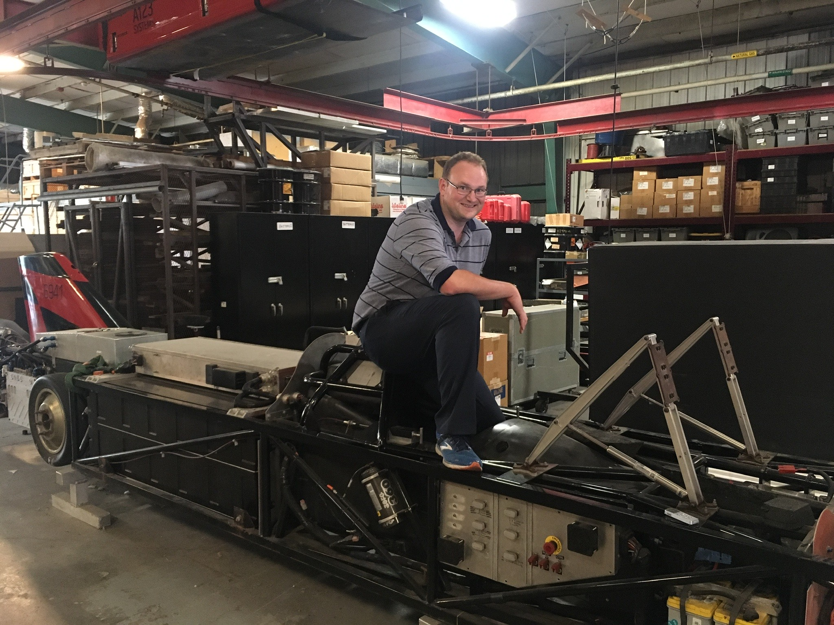
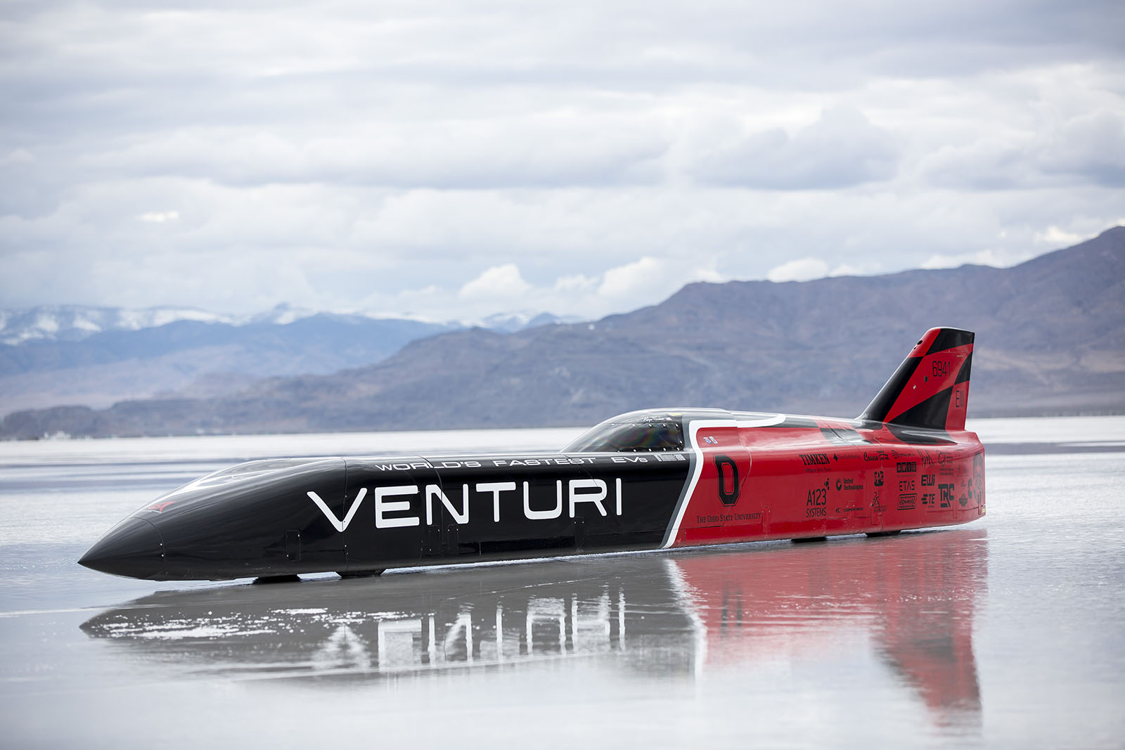
The world’s fastest electric car

Slide 23
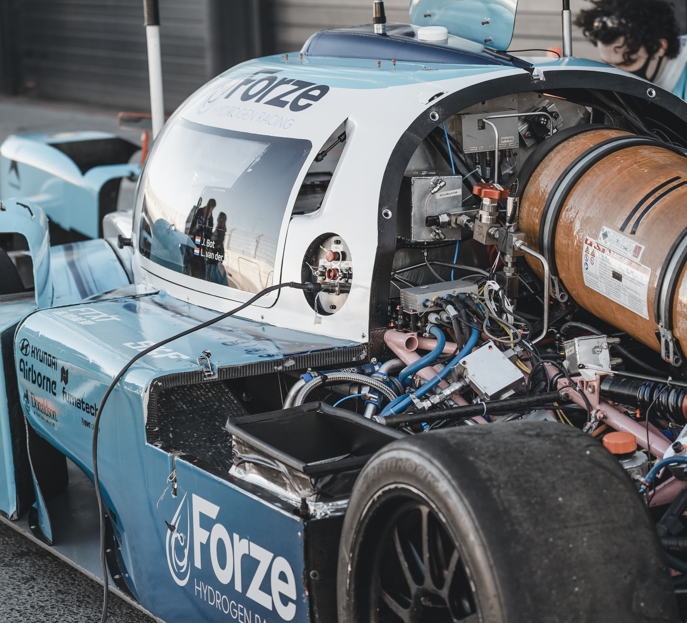
What will power the future?
Hydrogen power?
Biofuels?
Synthetic fuels?

Slide 24
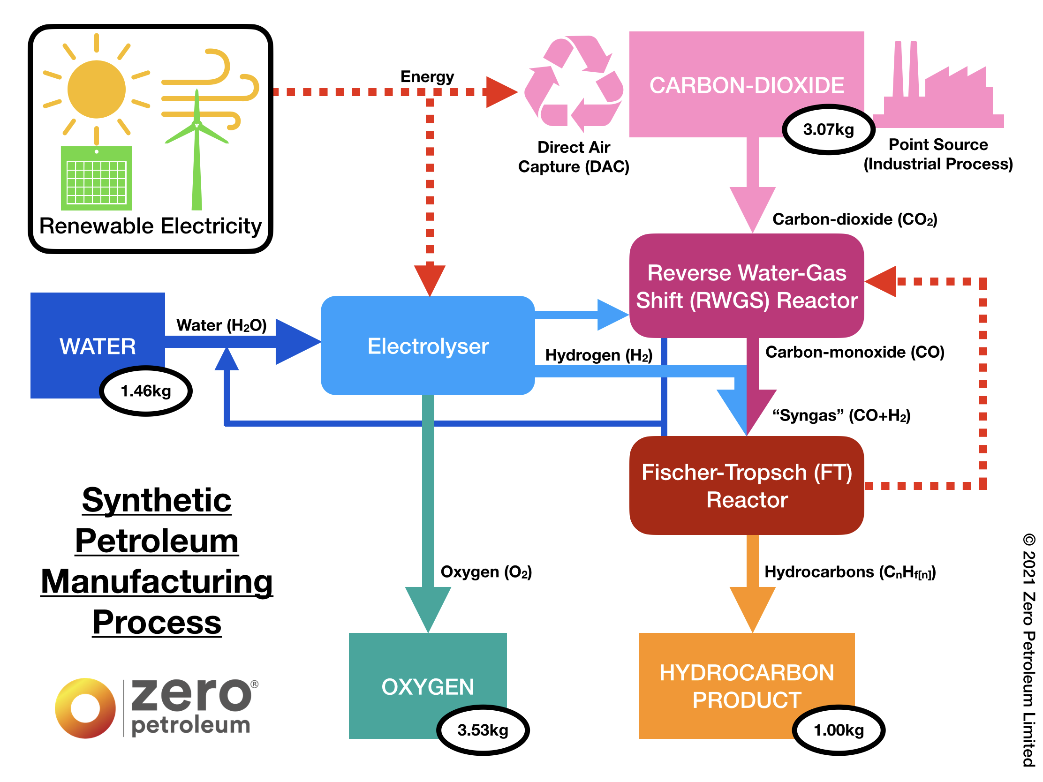

Slide 25
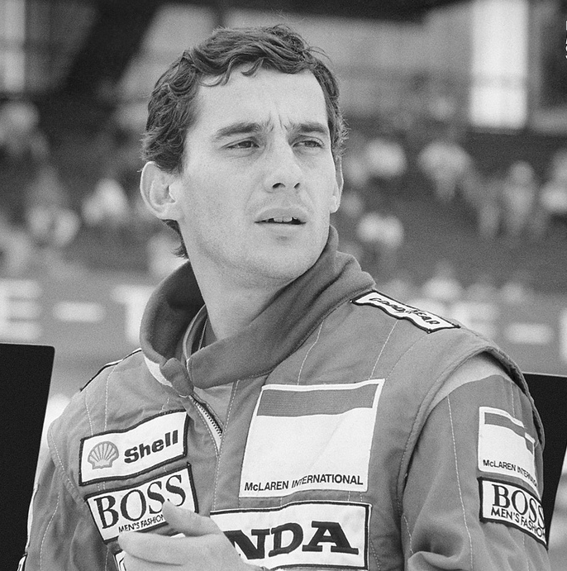
THE FUTURE OF DRIVERS

Slide 27
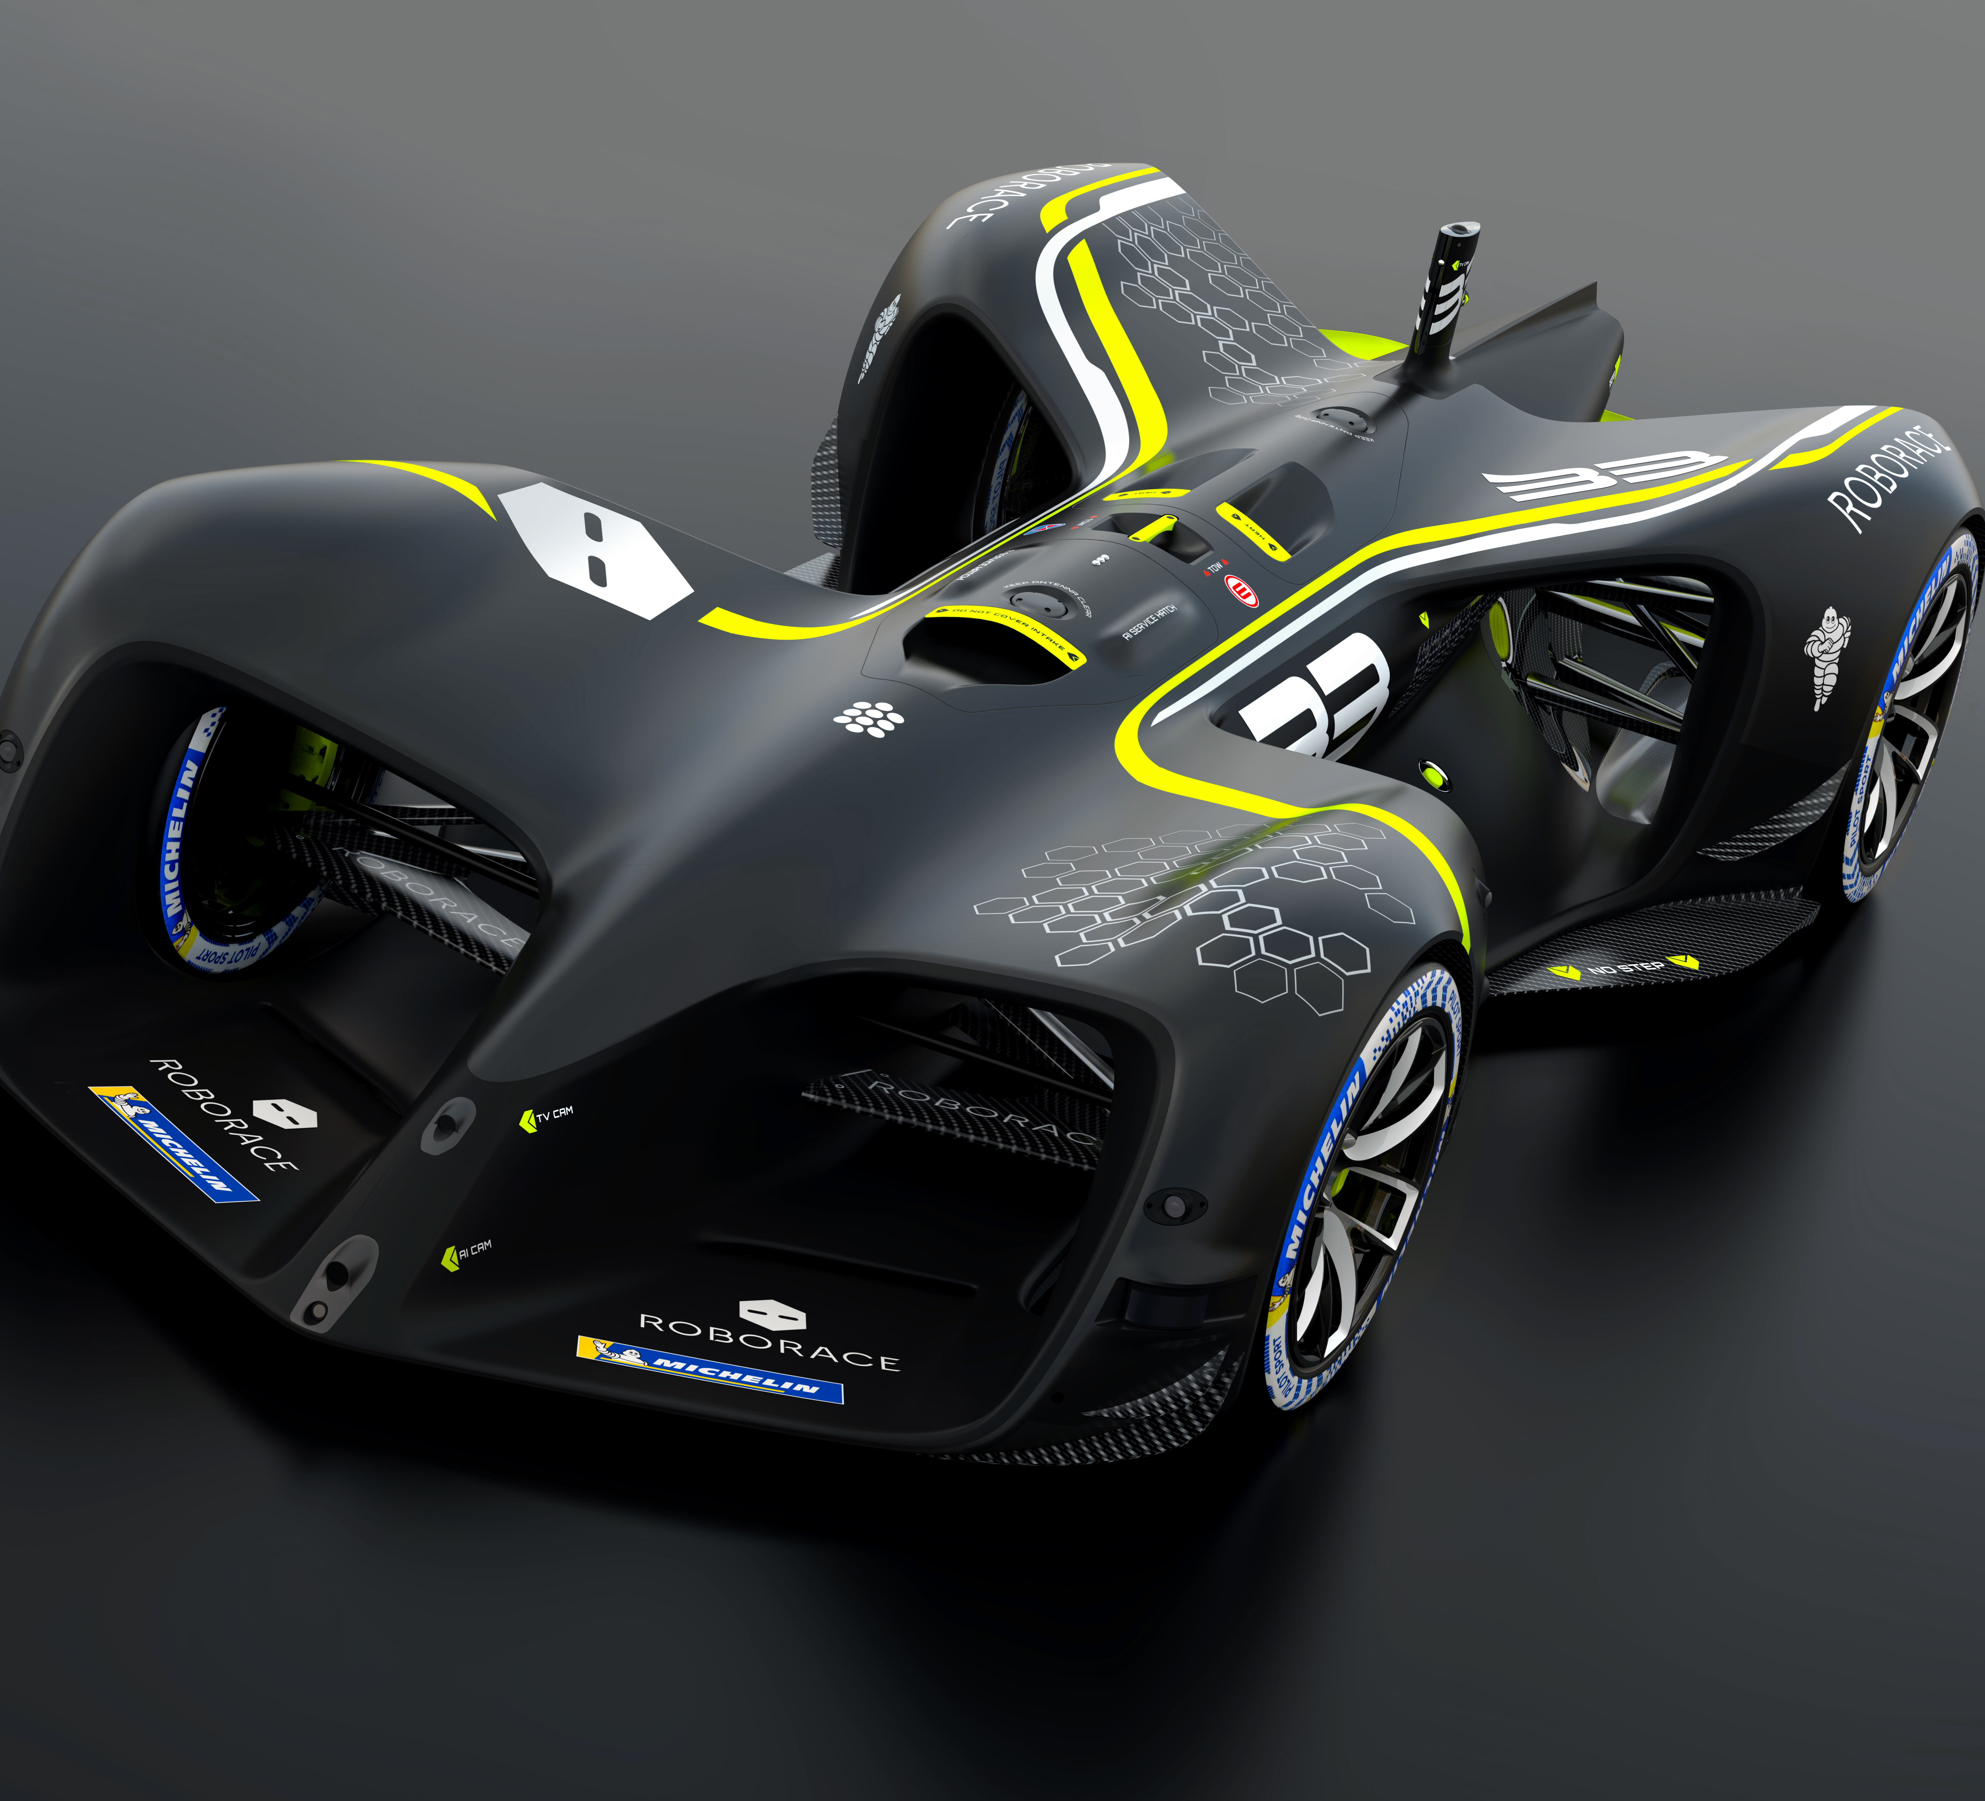
PERHAPS WE WON’T DRIVE OURSELVES AT ALL!

Slide 28
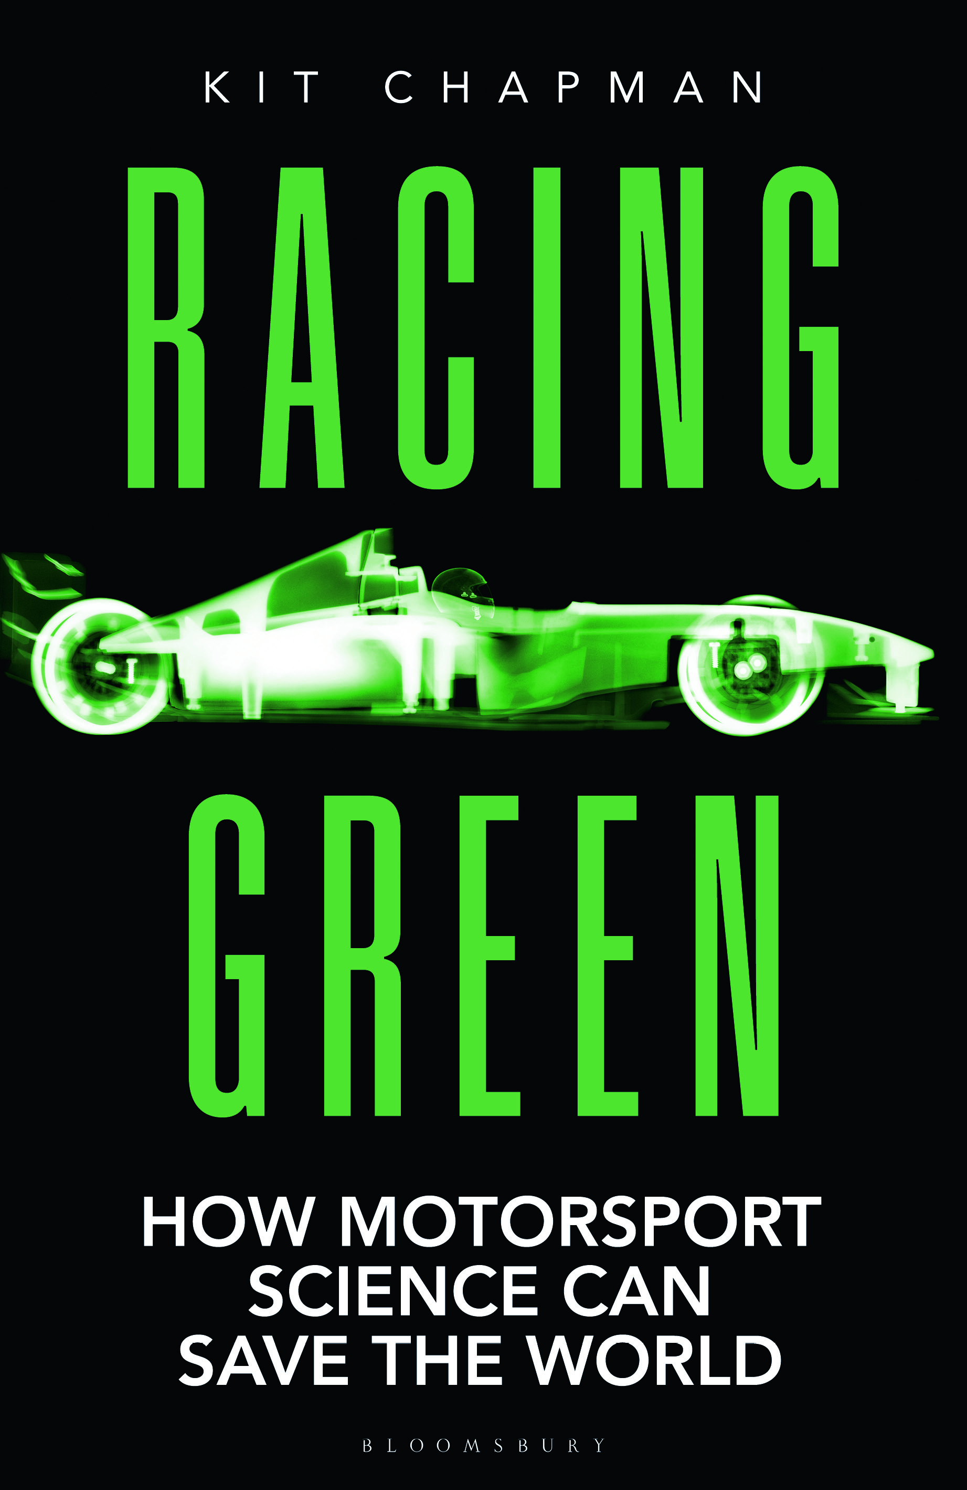
Racing Green: How MoTORSPORT SCIENCE CAN SAVE THE WORLD
Dr Kit CHAPMAN FalMOUTH UNIVERSITY
@ChemistryKit

