Slide 1

Inclusive Ethos: Stating the obvious?
Esther.cummins@falmouth.ac.uk
Esther.cummins@pgr.Manchester.ac.uk
@EstherM_Cummins
Notes:
Who I am, drawing on research and experience
Esther Cummins (she/ her) @EstherM_Cummins

Slide 2
What is the ethos of your setting?
What is your role in impacting this ethos?
@EstherM_Cummins

Slide 3
“Ethos is… a formal expression of the authorities’ aims and objectives for an organisation.”
(Donnelly, 2000, p135)
“Ethos emanates from individuals and group interaction and in this sense is not that which is formally stated or documented but is a process of social interaction; it is not independent from the organisation but inherently bound up within it.”
(Donnelly, 2000, p136)
@EstherM_Cummins
Notes:
Overlaps with values, culture, mission statement

Slide 4
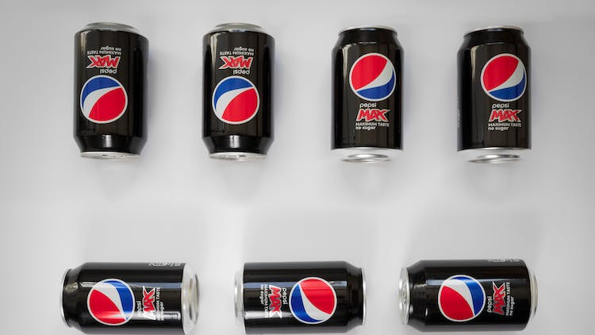
Pepsi CANS
Notes:
What do you expect if you buy Pepsi?- for them to taste like Pepsi. But sometimes with ethos statements we get coca cola, or lemonade, or oil…

Slide 5
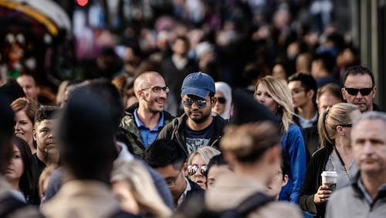
It is about people
Notes:
Isn't just because we want pepsi- human beings
Inclusion, equality, diversity, is all about people.
What can we do? Looking back to the statements of ethos, do you feel as if your ethos mirrors your experience? We need to recognise this won’t just happen!

Slide 6

Start the journey
Notes:
Mind the gap- we focus on this in terms of academic achievement but this is about the gap between what we say and what we experience. We need to think about this as a journey- not of us having an end point. We also have different starting points, so don’t panic about what yours is, but start the journey!
So what can we do?

Slide 7
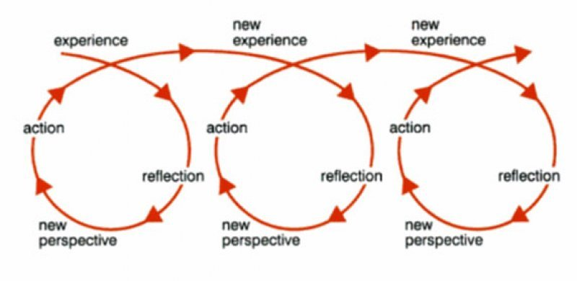
Changing the ethos
Jasper, 2003
@EstherM_Cummins

Slide 8
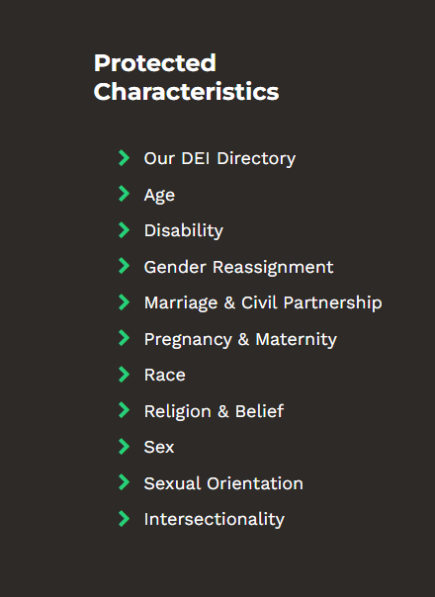
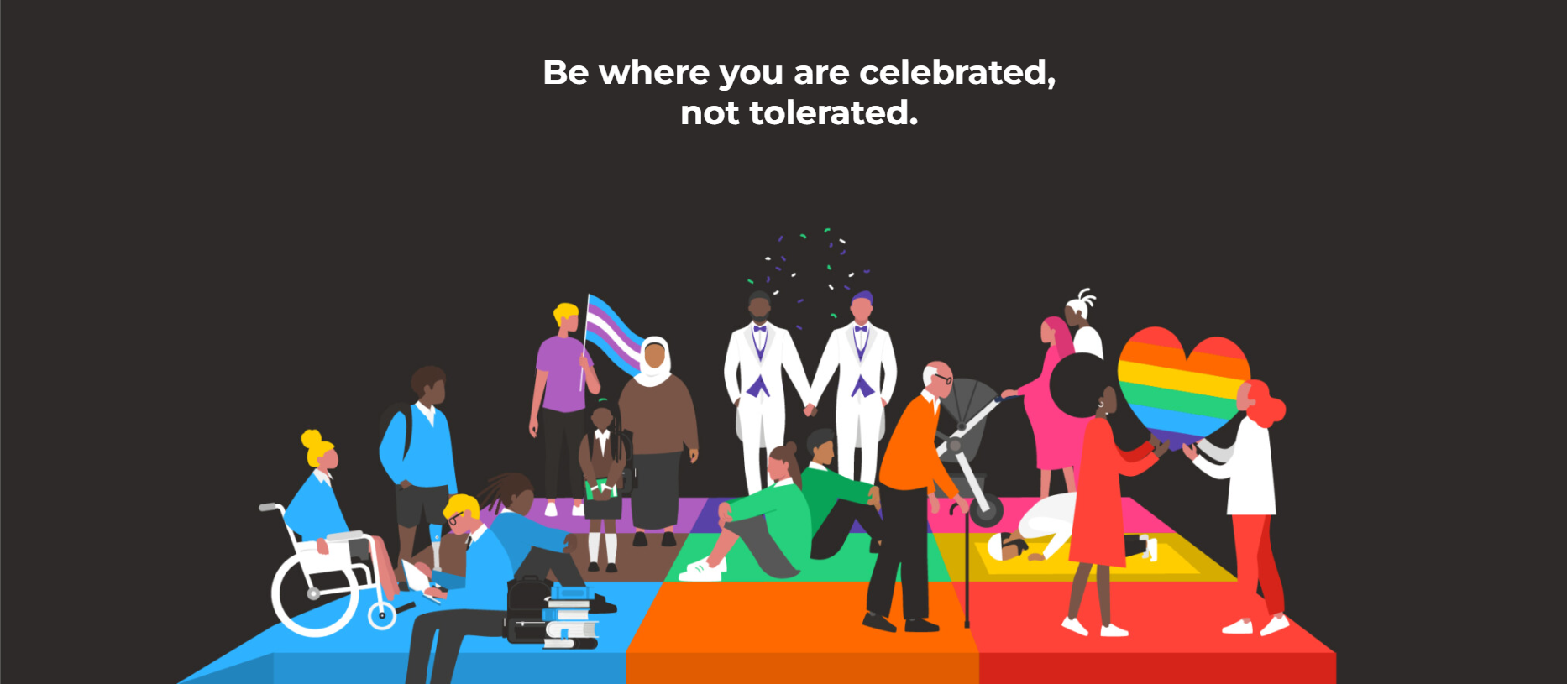
diversed
Embed
Return
Ask
Don’t impose
Don’t compare
@EstherM_Cummins

Slide 9
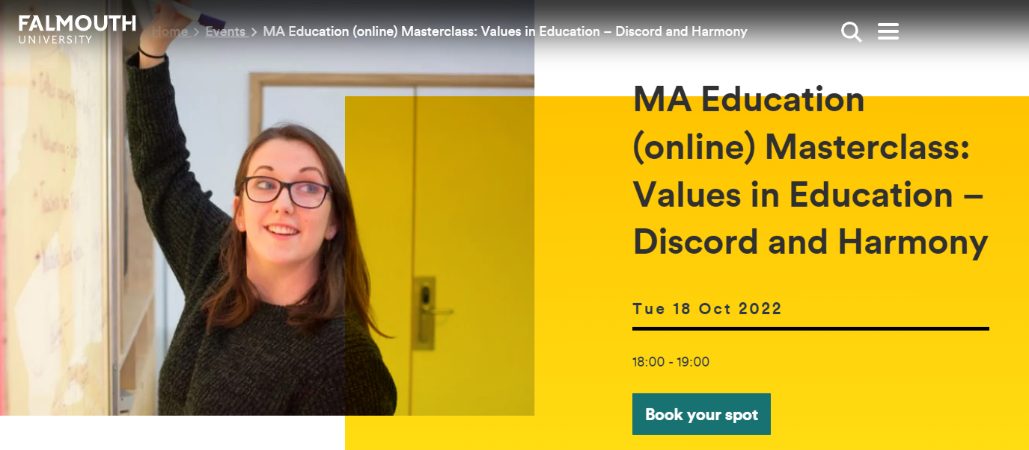
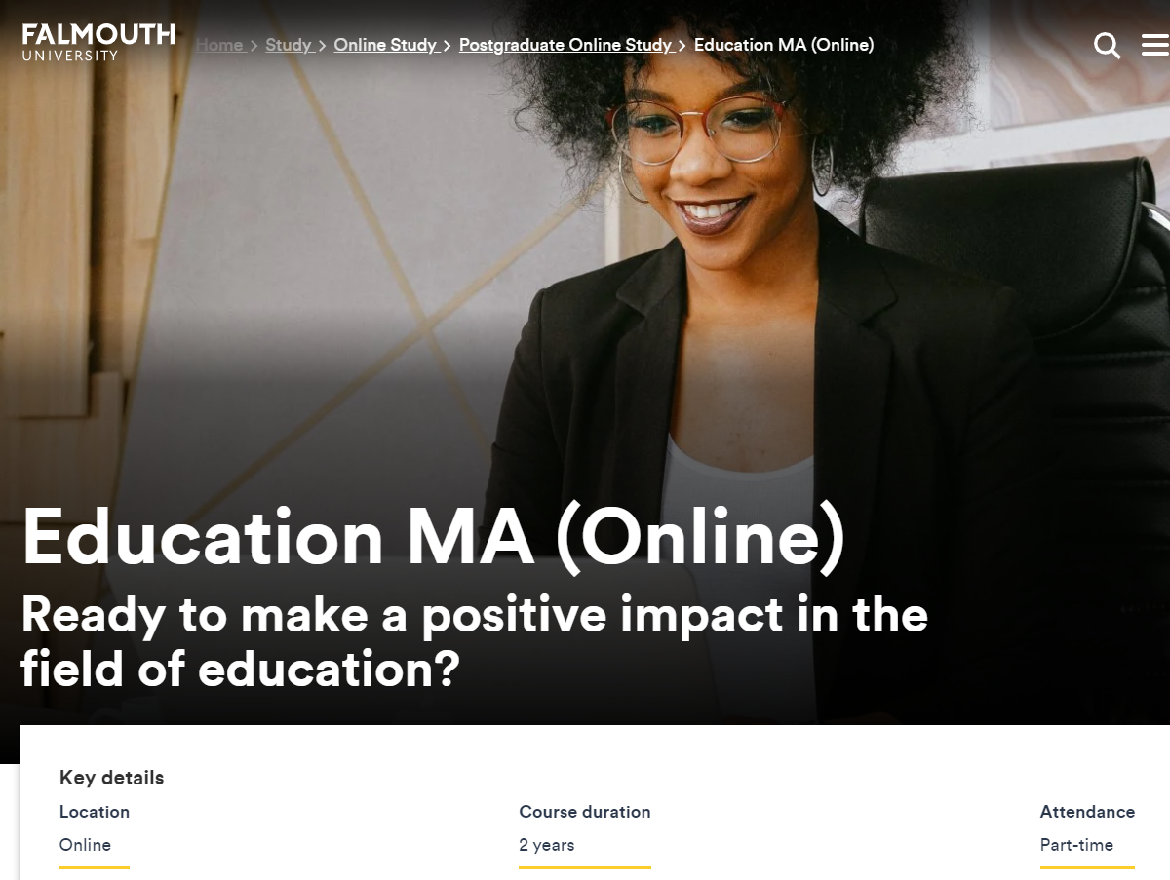
Want to know more?
Esther.cummins@falmouth.ac.uk
Esther.cummins@pgr.Manchester.ac.uk
@EstherM_Cummins

