Slide 1
DramaHE Conference: 29th and 30th June 2023, Staffordshire University Performance, Pedagogy and Practice
From Past to Present and the Future:
As the conservatoire dies, what should replace it?
Dr Trevor Rawlins
Head of Theatre Arts
Falmouth University

Slide 2
Actor Training
“What Training - For What Theatre?”
Barker, Clive. 1995. “What Training – for What Theatre?”, New Theatre Quarterly, 11: 42, pp. 99-108
Is “training” still the right word?
Is “theatre” still the right word?

Slide 3
Problematising “Training”
Tends towards focusing notions of practice, drill, repetition, skill development
Tends to focus notions of technical ”excellence”
Tends towards elitism
Tends towards exclusion rather than inclusion
Tends towards highlighting technical ability over critical ability

Slide 4
Problematising Theatre
Too narrow a definition of what an actor/performer does in c21st
What is different about acting/performing in digital realms?
What skills or technical abilities do actor/performers need beyond c20th notions of “theatre”?
What are the differences in process for digital/recorded work? (The issue of “staccato”)

Slide 5
Values
Creativity
Collaboration
Community
We are trying to define ourselves by these values for Performance at Falmouth
They are values I would have recognised as a drama student in the 1980s
Inclusive
Student centred

Slide 6
The actor/creator
Daisy May Cooper
Michaela Cole
Aisling Bea
Would those values chime with these artists?
Drama School training did not

Slide 7
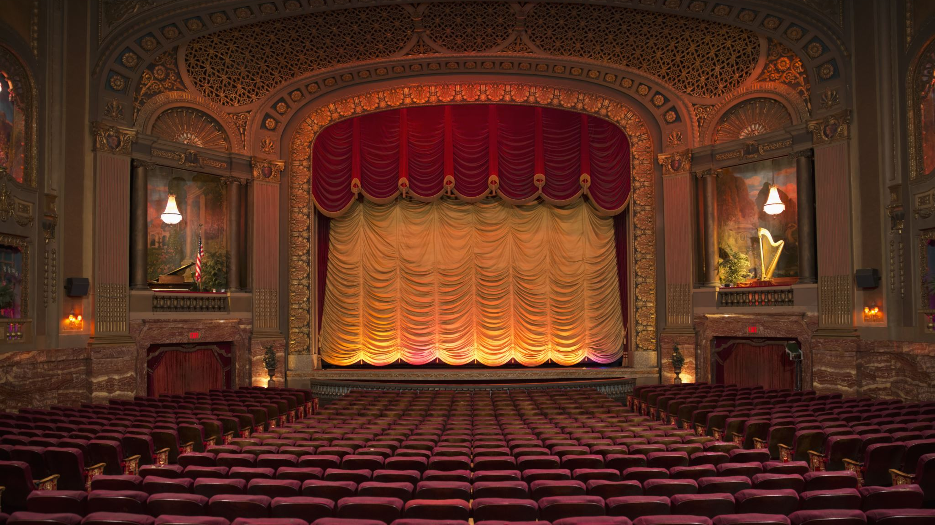
Learning outcomes: The problem with performance
Construct and develop an embodied application of a range of Musical Theatre techniques, incorporating genre, character and performance.
Present and communicate effectively and appropriately an embodied application of a range of acting techniques, and an understanding of material, audience, role and context
Consolidate a range of appropriate embodied approaches and skills to performance.
Explore the process of creating and performing solo material using a range of compositional strategies, generative techniques, technologies and performance skills

Slide 8
Assessment
Should we assess performance at all?
What is the value of assessing a performance?
If we do, how do we fairly assess performance?
How do we maintain an inclusive approach?
How do we tailor assessment that focuses the individual student?
What are the learning outcomes that we really value?

