Slide 1
Startup Incubators – Which Way Now?
Developmental Paper - Ananya Banerjee

Slide 2
Abstract
Entrepreneurship is believed to be a new way of capitalist development (Bruin, 1998). Job creation, innovation, and growth are important elements of a capitalist society which are associated with entrepreneur-driven startups. Startups are the new businesses formed in the countries and often play a vital role in the development of a country’s economy and innovation ecosystem. New businesses play a crucial role in fostering economic growth and development in both emerging and advanced economies. They have significant contribution in job creation, innovation, competition, and the overall health of an economy (Reynolds et al. 1994). Startup incubators help foster new and developing business ideas to be developed into working products ready for scale up. This paper investigates the importance of further research into the sustainable business models of startup incubators, within the realm of sustainable business and management practices.

Slide 3
Methodology
This paper is a developmental narrative review (Rother, 2007) of the relevant literature talking about new businesses and the importance of business incubators.

Slide 4
Importance of Startups
Startups are known to have been a way of entrepreneurs working towards creating jobs (de Moraes Jardim, et al., 2020). Defining the term startup has been quite a bit of struggle. Cockayne (2019) defines a startup to be a new business that is an actual type of firm or working practice and receives privileged treatments through economic policy. They are new, modern, and often involves innovative work. Startup as a form of new business play a vital role in the development of a country’s economy and innovation ecosystem. New businesses play a crucial role in fostering economic growth and development in both emerging and advanced economies. They have significant contribution in job creation, innovation, competition, and the overall health of an economy (Reynolds et al. 1994). A dataset from the U.S. government has identified that startups are the only significant source in job creation (Kane, 2010). Startups are also now recognised for their innovation and growth (Garg and Gupta, 2022). If a business organisation is aiding to a country’s economy to such an extent, it is only fair to look into the support system that fosters such startups.

Slide 5
Startup Incubators
Startup businesses have access to different supporting infrastructure often created by both governmental and private organisations. They include incubators, accelerators, innovation labs etc. Out of these, it is the business incubators that help kickstart a business from the idea stage and help them grow into a workable product. They have become an important part in fostering entrepreneurship and innovation (Gerlach and Brem, 2015).
The history of startup incubators is relatively short with the first recorded history being only in the year 1959 named Batavia Industrial Centre in a Batavia, New York (Kilcrease, 2012). However, in the matter of less than 75 years, it is estimated that there are 7000 business incubators. Incubators, being small and medium enterprises that help with the growth of such new businesses, play a pivotal role in a country’s ecosystem. Looking into their sustainable business models is important not just for identifying the more efficient business model, but they also form a pivotal role in the United Nations’ Sustainable Development Goals (Bexell et al., 2017), more specifically, goal number 9 – Industry, Innovation, and Infrastructure.

Slide 6
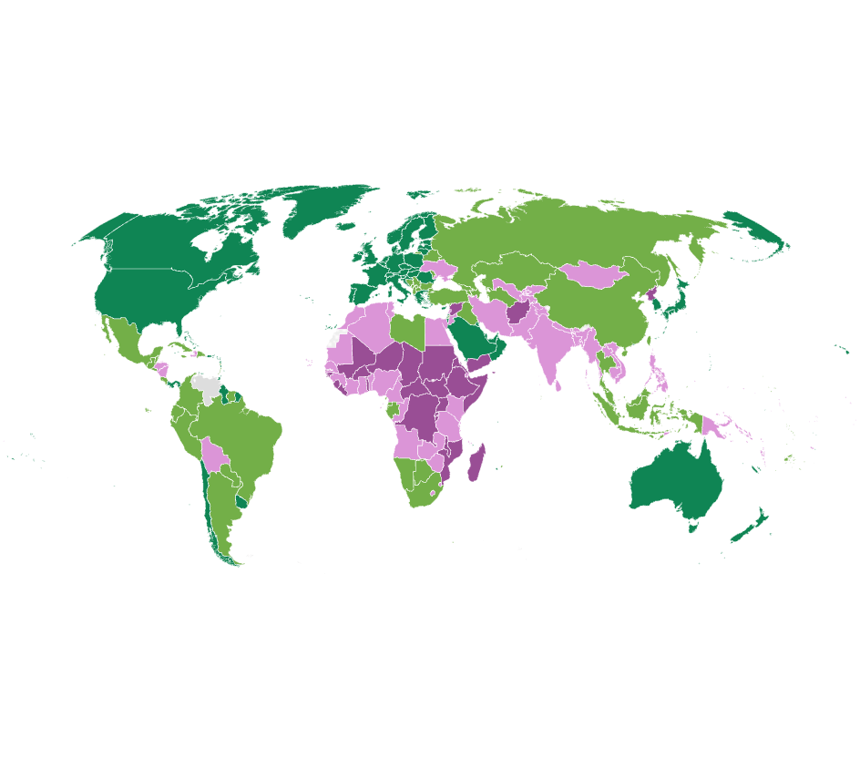
Research Gap
It is important to look into the incubator ecosystem within the United Kingdom. The UK is one of the world's largest economies, making it a crucial player in the global economic landscape (World Bank, 2021). It also has a strong tradition of investing in research and development, fostering innovation across sectors (HM Treasury, 2021). This makes conducting a research study in the UK a good market to study SMEs that foster startup ecosystem. Moreover, in 2017, the UK Government published a study on, “Business incubators: the national picture” (Bone et al. 2017). This study was followed by another study published in 2019 “The impact of business accelerators and incubators in the UK” (Bone et al. 2019). The 2019 study identified the scope of further research into the cost-effectiveness of incubators and accelerators, return on investment, and sustainability of the business models. It also identified a limitation in the scope which is the lack of differentiation between startup incubators and accelerators.

Slide 7
Sustainable Incubators
Innovative business plans help organisations have a competitive advantage and improve sustainability performance (Nosratabadi, et al., 2019). It is important to investigate the sustainable business models of startup incubators in the UK to determine which way the startup incubators should be built to be efficient in helping startups as well as continue to build a sustainable business model.
Sustainable business models are believed to be important elements for delivering social and environmental sustainability (Lüdeke-Freund, 2010.). However, there are constraints for understanding these business models. The reason why it is even more important to look into the sustainable business models of business incubators because even after several research studies, there is nothing comprehensive about how they could implement sustainability throughout their business models (Nosratabadi, et al., 2019).

Slide 8
Conclusion
Startups are crucial for economic growth of a country. Business incubators help foster entrepreneurship and startup growth. Looking into their sustainable business models and doing further research will help build better understanding and bridge the research gap.

Slide 9
References
Bexell, M. and Jönsson, K., 2017, January. Responsibility and the United Nations’ sustainable development goals. In Forum for development studies (Vol. 44, No. 1, pp. 13-29). Routledge.
Bone, J., Gonzalez-Uribe, J., Haley, C. and Lahr, H., 2019. The impact of business accelerators and incubators in the UK.
Bone, J, Olivia A, and Christopher H. 2017. “Business Incubators and Accelerators: The National Picture (Research Paper No. 7).” BEIS. https://assets.publishing.service.gov.uk/government/uploads/system/uploads/attachment_data/ file/608409/business-incubators-accelerators-uk-report.pdf.
Bruin, A.D., 1998. Entrepreneurship in a new phase of capitalist development. Journal of Interdisciplinary Economics, 9(3), pp.185-200.Cockayne, D., 2019. What is a startup firm? A methodological and epistemological investigation into research objects in economic geography. Geoforum, 107, pp.77-87.
de Moraes Jardim, M.P., Macêdo, K.B. and Oliveira, D.P., 2020. Startups, entrepreneurship, or employability condition?. International journal of advanced engineering research and science, 7(5).
Fig 1: Tsaplin, E. and Pozdeeva, Y. (2017) ‘International Strategies of Business Incubation: The USA, Germany and Russia’, International Journal of Innovation, 5(1), pp. 32–45. doi:10.5585/iji.v5i1.130.
Garg, M. and Gupta, S., 2022. Startups and the growing entrepreneurial ecosystem. Journal of Intellectual Property Rights (JIPR), 26(1), pp.31-38.
Gerlach, S. and Brem, A., 2015. What determines a successful business incubator? Introduction to an incubator guide. International Journal of Entrepreneurial Venturing, 7(3), pp.286-307.
Kane, T.J., 2010. The importance of startups in job creation and job destruction. Available at SSRN 1646934.
Kilcrease, K., 2012. The Batavia industrial center: the hatching of the world's first business incubator. New York History, 93(1), pp.71-93.
Lüdeke-Freund, F., 2010. Towards a conceptual framework of'business models for sustainability'. Knowledge collaboration & learning for sustainable innovation, R. Wever, J. Quist, A. Tukker, J. Woudstra, F. Boons, N. Beute, eds., Delft, pp.25-29.
Microsoft (2022). Startups disrupting industries and changing the world—and doing it all at scale. [online] CEE Multi-Country News Center. Available at: https://news.microsoft.com/en-cee/2022/09/20/startups-disrupting-industries-and-changing-the-world-and-doing-it-all-at-scale/#:~:text=There%20are%20150%20million%20startups.
Nosratabadi, S., Mosavi, A., Shamshirband, S., Zavadskas, E.K., Rakotonirainy, A. and Chau, K.W., 2019. Sustainable business models: A review. Sustainability, 11(6), p.1663.
Reynolds, P., Storey, D.J. and Westhead, P., 1994. Cross-national comparisons of the variation in new firm formation rates. Regional studies, 28(4), pp.443-456.
Rother, E.T., 2007. Systematic literature review X narrative review. Acta paulista de enfermagem, 20, pp.v-vi.
World Bank Group country classifications by income level (2022) blogs.worldbank.org. World Bank. Available at: https://blogs.worldbank.org/en/opendata/new-world-bank-group-country-classifications-income-level-fy24 (Accessed: 25 May 2024).

Slide 10
Ananya Banerjee
Ananya is a doctoral researcher, an educator, problem solver, entrepreneur, lecturer, lawyer, author, and startup advisor with 10+ years of entrepreneurial, academic, and advisory experience.
In addition to being a doctoral researcher, Ananya is currently a Lecturer in Digital Marketing at Cornwall Business School, Falmouth University. In her role as a lecturer, she is leading the marketing modules at the business school's undergraduate courses and leading the social media and outreach of the school. In her bigger role as an educator, she is collaborating on knowledge exchange projects with industry partners.
Before academia, Ananya founded and worked in two startups working with United Nations Sustainable Development Goals in different markets. She also founded and exited Unico Legale, a legal and strategy firm, and ran a philanthropic venture in data-driven business decision-making - both in the Indian market. She has completed working with startups, incubator managers, and the Wadhwani Venture Fastrack (partnered with Bill and Melinda Gates Foundation) team as a Startup Fellow, to strategize and deliver workshops, coach startups, and help incubators build robust programs. She has published her book on achieving operational excellence for early-stage startups, based on a 6S framework she devised from her knowledge of lean Six Sigma and agile methodologies.
Ananya has delivered keynote speeches on startup compliance, viability, sustainability, and when to quit at various conferences and continues to train young adults on different relevant issues.
Research interests
Sustainability with a business focus.
Circular Economy
Startup Ecosystem

Slide 11
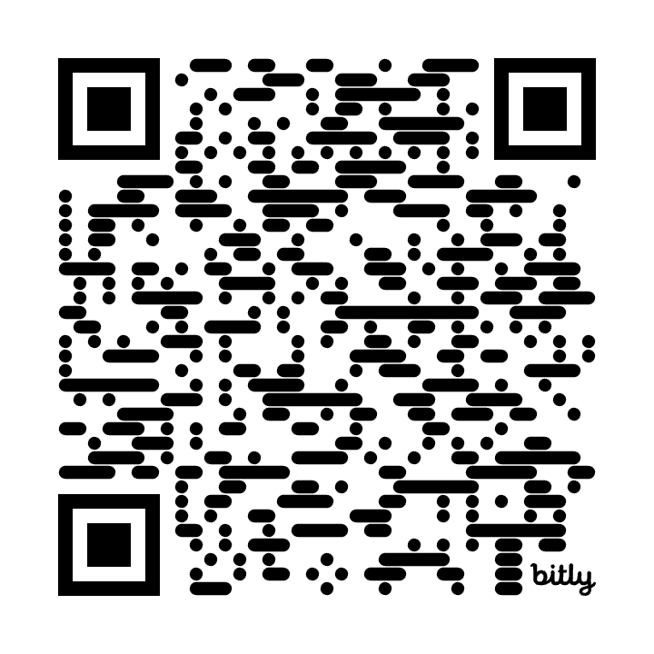
Thank you for listening.
Any questions?
If you have any feedback, want to have a conversation about my research, or could help me connect with incubators in the UK, please email at: ananya.Banerjee@falmouth.ac.uk
Or
connect with me on LinkedIn:
https://bit.ly/linkedinAnanyaB

