Slide 1
Intro. to User Experience (UX) & Journey Mapping
Dr James Branch james.branch@falmouth.ac.uk
James Chudley james.chudley@cxpartners.com

Slide 2
Speakers & Facilitators
Dr James Branch
Senior lecturer at Falmouth University with a PhD in UX Pedagogy
James Chudley
Highly experienced UX consultant working at CXPartners in Bristol

Slide 3
Workshop Schedule
11:00 – 12:00 – Introductions + User Experience Design 101
Break – Refreshments
12:20 – 13:00 – Intro. to Journey Mapping + Healthcare Exercise
Break – Lunch
13:30 – 15:30 – Apply Journey Mapping to your business/organisation

Slide 4
Workshop Objectives
Explore user-experience design (UX)
Identify value of UX for your business/service
Apply Journey Mapping to uncover opportunities for improvement / innovation

Slide 5
User Experience Design 101
What is UX?
What are the benefits?

Slide 6
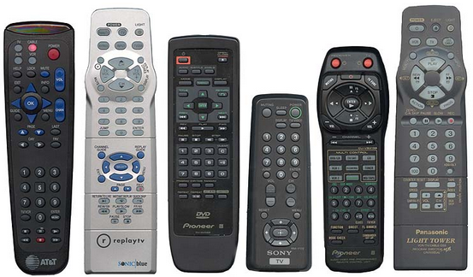
Confusing design
Notes:
Scenario 1: Relative at Xmas Scenario 2: Teaching in a new building/room Have you ever struggled with a TV remote and to get it to do what you want Why does that happen? Company priorities / Engineering priorities / But little thought for users priorities A Uxers job is to be the person in the room advocating for users/customers needs.

Slide 7
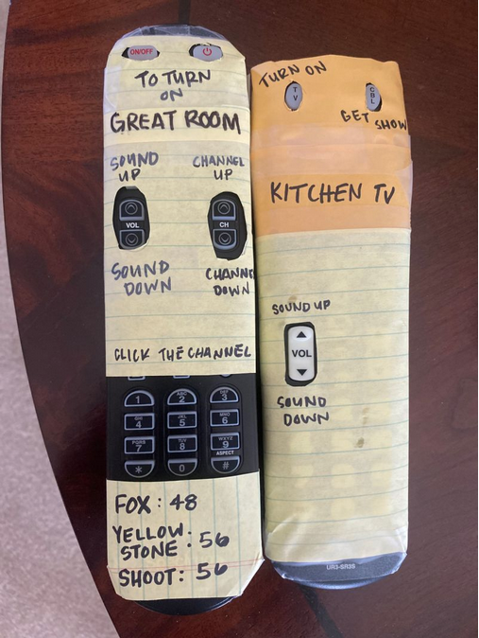
User-friendly design
Notes:
Amy Dalton – redesigned this TV remote to meet the need of a relative with a cognitive impairment Often so called ‘extreme users’ can help us to identify an effective design that works for everyone

Slide 8
UX optimises design for what users want and need
Notes:
UX optimizes the design around how users can, want, or need to use the product, rather than forcing the users to change their behavior to accommodate the design. UX has it’s roots in human factors and ergonomics where industrial designers like Henry Dreyfuss used extensive understanding of our bodies and perceptions to improve the design of cars, offices, furniture When computing moved out of office into the home computers and internet needed to be more intuitive to use — and Apple pioneered UX usability with friendly interface GUI – The goal is to make interfaces effective, efficient and satisfying for users. This is important as more and more aspects of our lives are subject to digital transformation — Software, apps, but also now really services that span across physical and digital touchpoints

Slide 9
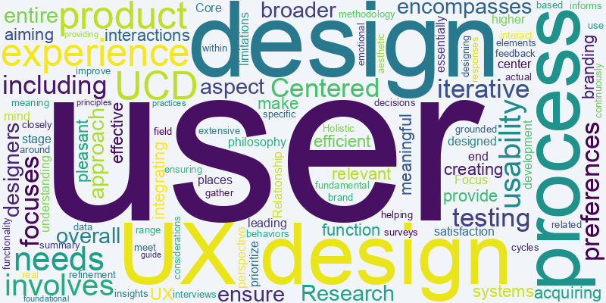
The terminology is confusing

Slide 10
UX can mean the properties of an interface “This app has great UX!” “The UX of this website is terrible.” “We really need to improve the UX of this interface.”

Slide 11
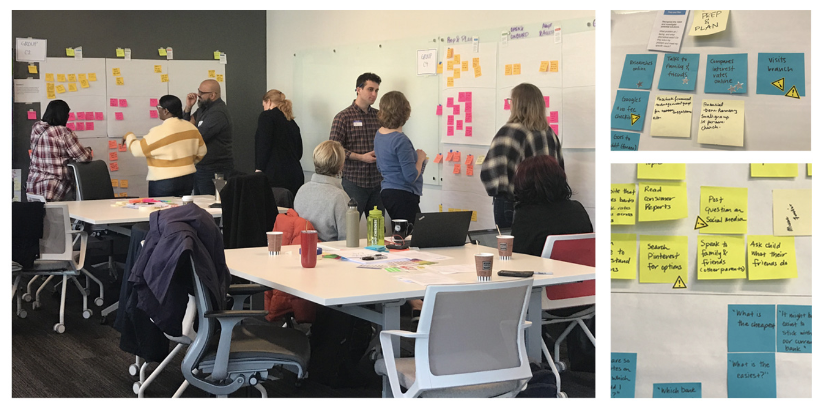
UX also refers to a sub-field of the design profession

Slide 12
UX is also a person’s experience with a product or service

Slide 13
Your organisation is delivering a user experience regardless of how much time, energy, and resources you’re putting into shaping it

Slide 14
Is your organisation doing good user experience right now? (This is a difficult question)

Slide 15
UX Philosophy
“The primary factor in a successful design project is a deep understanding of the users' needs and context.” Source: Alan Cooper
Notes:
UX tries to make products services better, more intuitive, enjoyable to use by being the person in the room that is focussing on users and user needs alongside the technical people and business people. This is important as more and more aspects of our lives are subject to digital transformation — Software, apps, but also now really services that span across physical and digital touchpoints

Slide 16
UX Principles
1. Early Focus on Customers/Users + Tasks
2. Prototype and Test
3. Iterative Design
Notes:
• First principle identifies designers should first understand who the users will be by studying their behaviour through direct contact. • Second, early on in the development process, users should try out simulations and prototypes and their reactions should be observed, recorded andanalysed. • Finally, designer should embrace iterative rounds of development in a cycle of design, measure, and redesign (Gould and Lewis, 1985).

Slide 17
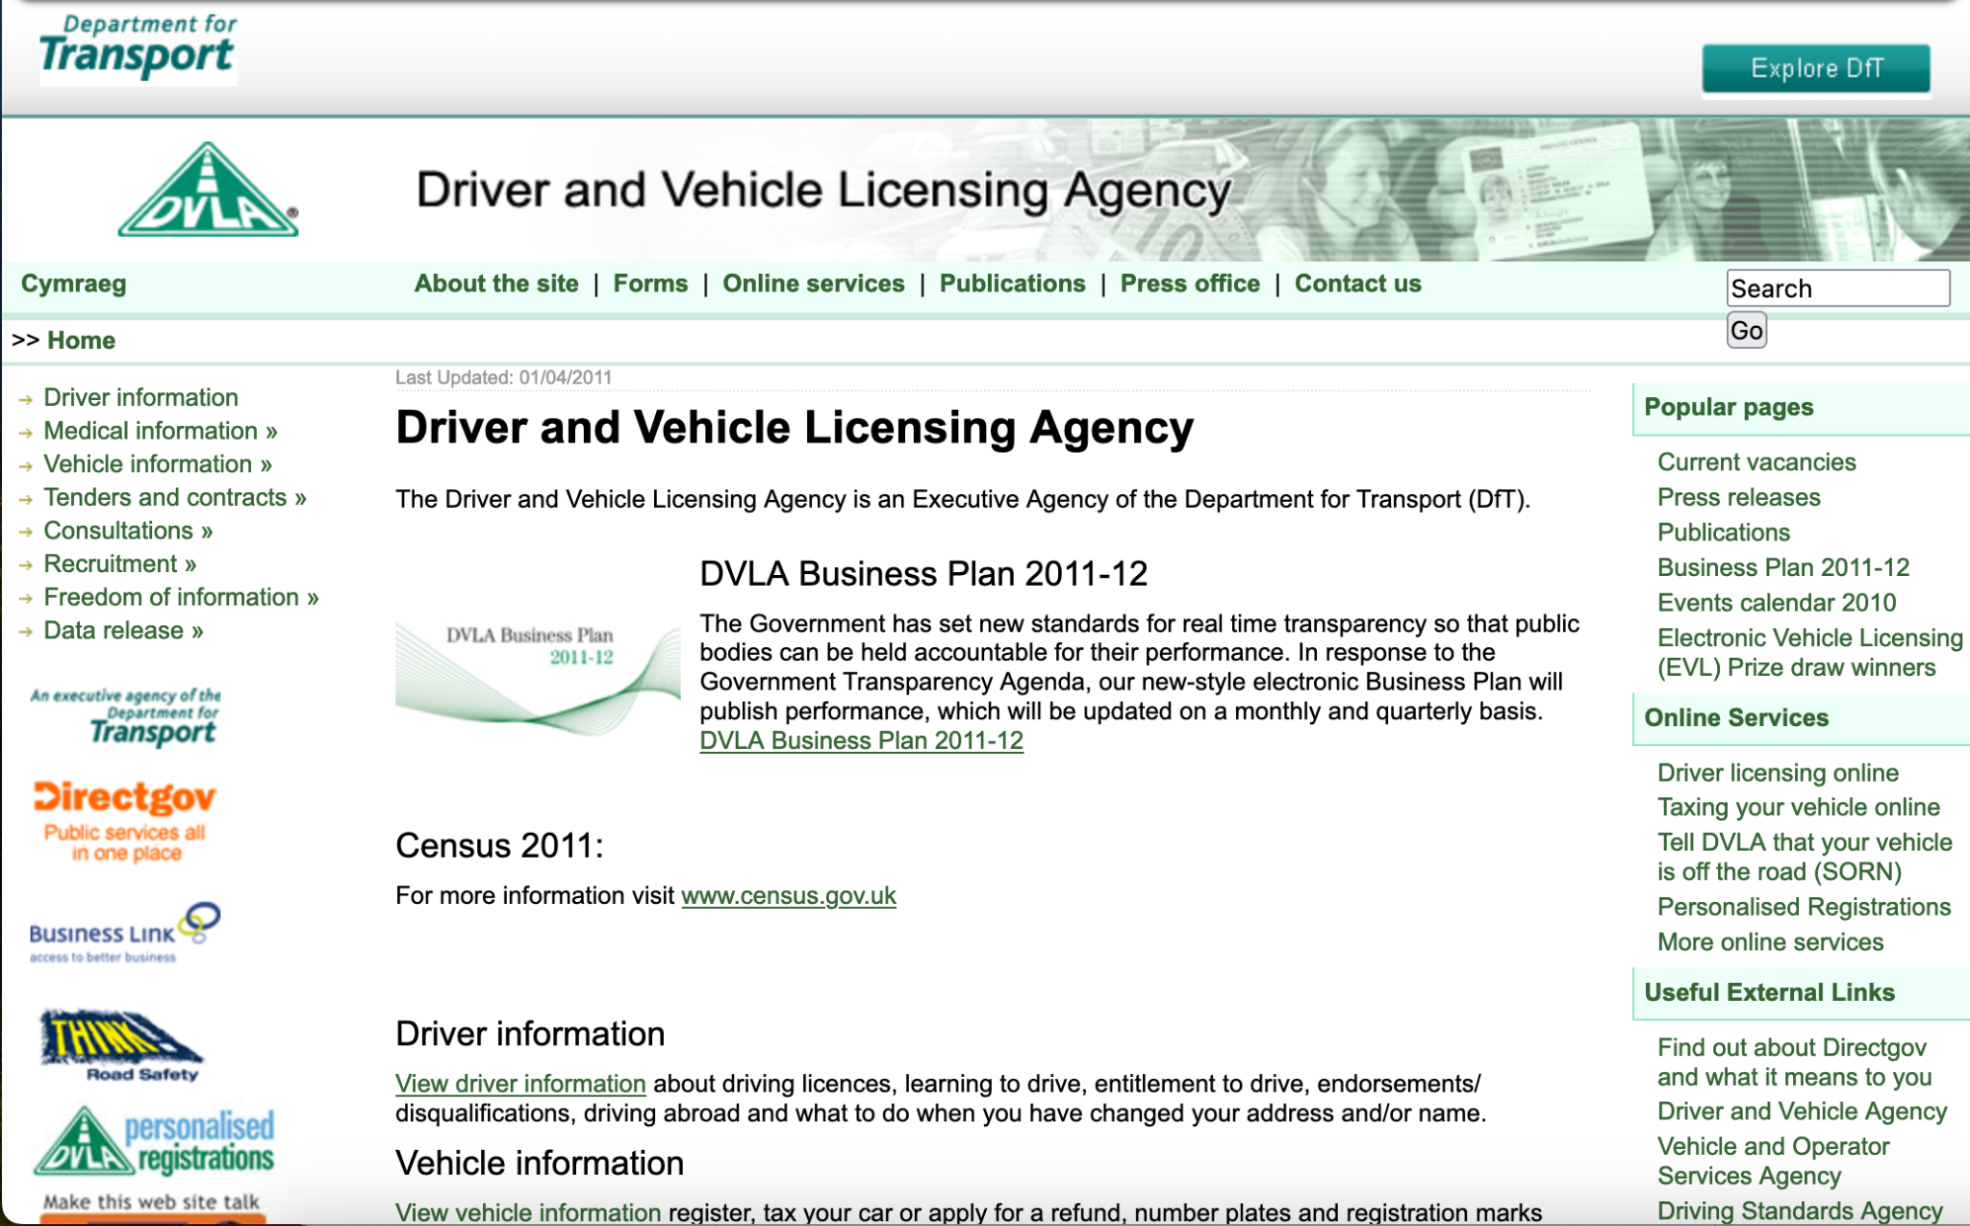
Example of a website designed more around needs of business / organization and less the user

Slide 18
Example of a website designed more around the user’s needs

Slide 19
What are the benefits?
“Your customers aren't won over by features. They're won over by the product/service experience… If you don’t focus on the experience you’ll ﬁnd your users lost, confused, or bored, and likely to walk away.”
Source: Lee Dale – UX Magazine

Slide 20
Deeply understanding your customers means:
Less risk – Fewer bad ideas making it into delivery
Better products/services by addressing real problems/needs
Opportunities to not only improve but also innovate
Happy customers stick around – Improved loyalty and retention

Slide 21
Take a Break (20mins)
Dr James Branch james.branch@falmouth.ac.uk
James Chudley james.chudley@cxpartners.com

Slide 22
Exercise Journey Mapping (40mins)
Dr James Branch james.branch@falmouth.ac.uk
James Chudley james.chudley@cxpartners.com

Slide 23
Part 2: Workshop Objectives
Think about your customers
Think about what the experience is like of engaging your business
Think about how you might improve the experience

Slide 24
Customer Journey Mapping
“Journey mapping is a tool that helps organisations to understand the experience a customer has with their product or service”

Slide 25
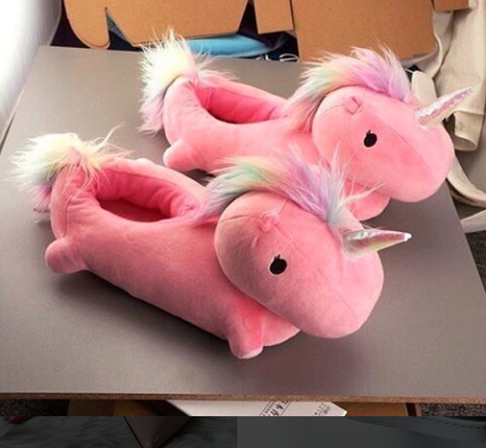
Step 1
Put yourself in someone else's shoes

Slide 26
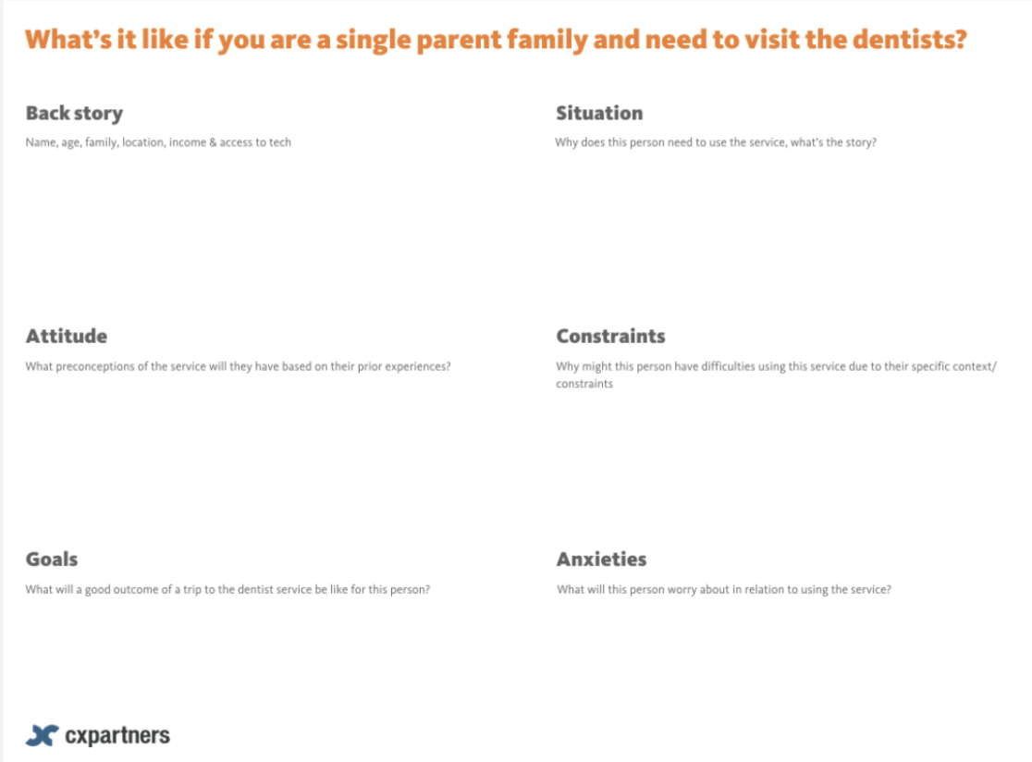
What is it like if you are a single parent family and need to visit the dentist

Slide 27
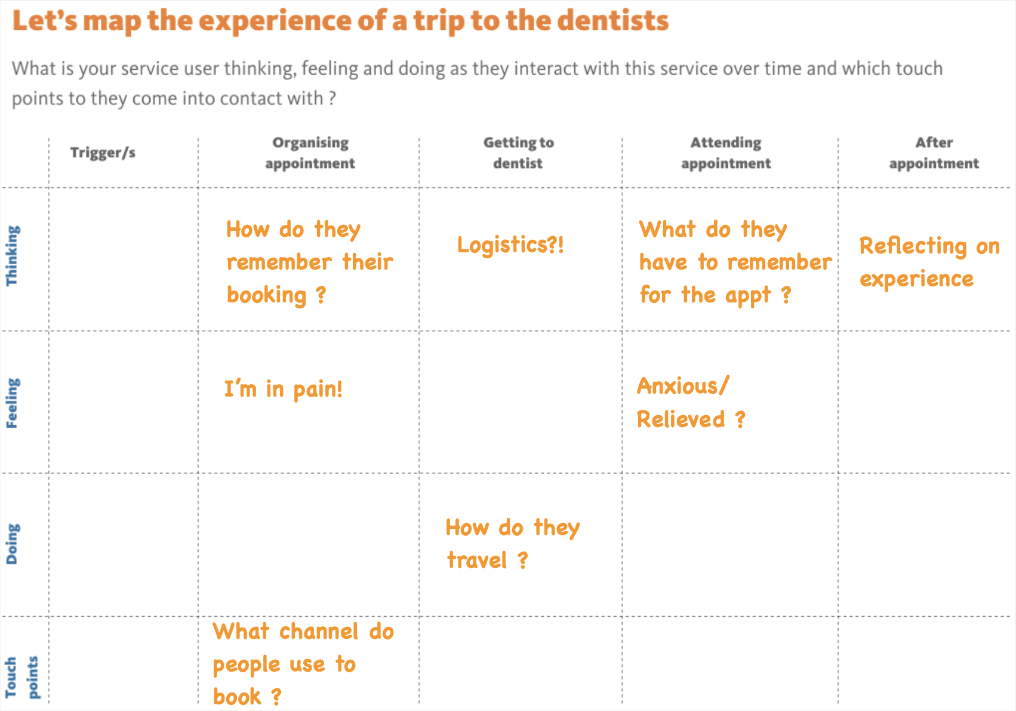
Step 2
Let’s map the experience of a trip to the dentists

Slide 28
Group Exercise (30 minutes)
Dr James Branch james.branch@falmouth.ac.uk
James Chudley james.chudley@cxpartners.com

Slide 29
Now let’s investigate the experience of going to the doctor:
Who is using the service?
What’s happening during the service experience?
Where are the pain points on the service?
What could help fix the broken bits?

Slide 30
Who is using the service?
Single-parent and child
International student
Rurally based young professional

Slide 31
Step into another person’s shoes
Notes:
Objectives • Put yourself in someone
else's shoes
• Understand what is
important to other people
• Practice empathy skills
• Use artistic licence!

Slide 32
Now map the experience

Slide 33
Where are the pain points on the service?
Identify where the service feels
the most ‘broken’ from the
perspective of the user

Slide 34
How might you fix the problem
Think of some ways you could
help fix the problem?

Slide 35
Take your key pain point i.e.
‘Service user anxious about pain before treatment’
Can you develop some solutions?
Come up with as many ideas as you can!

Slide 36
Lunch Break (60 minutes)
Dr James Branch james.branch@falmouth.ac.uk
James Chudley james.chudley@cxpartners.com

Slide 37
Focus on your own business or service 2 hours
Dr James Branch james.branch@falmouth.ac.uk
James Chudley james.chudley@cxpartners.com

Slide 38
Step into your customer’s shoes

Slide 39
Now map the experience for your business

Slide 40
Thank you – Any questions?
Dr James Branch james.branch@falmouth.ac.uk
James Chudley james.chudley@cxpartners.com

