Slide 1
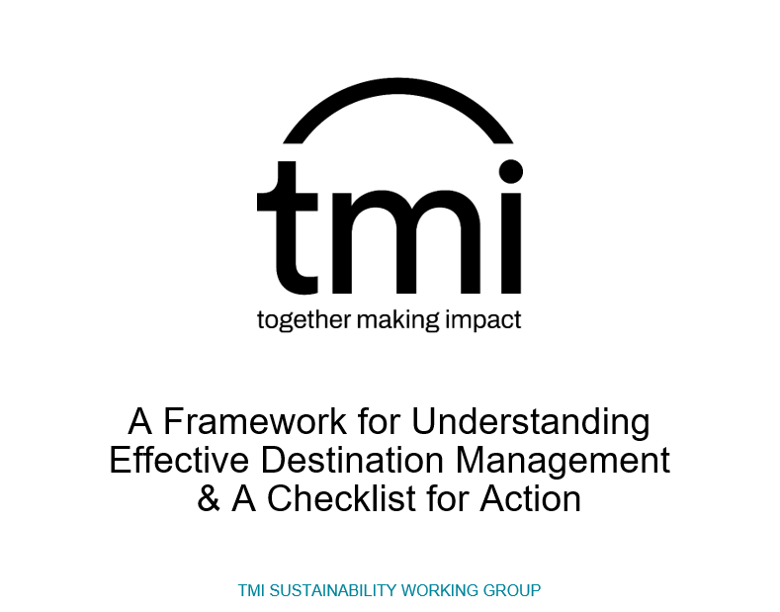
Presented by:
Peter Lane
Dr Natalie Semley

Slide 2
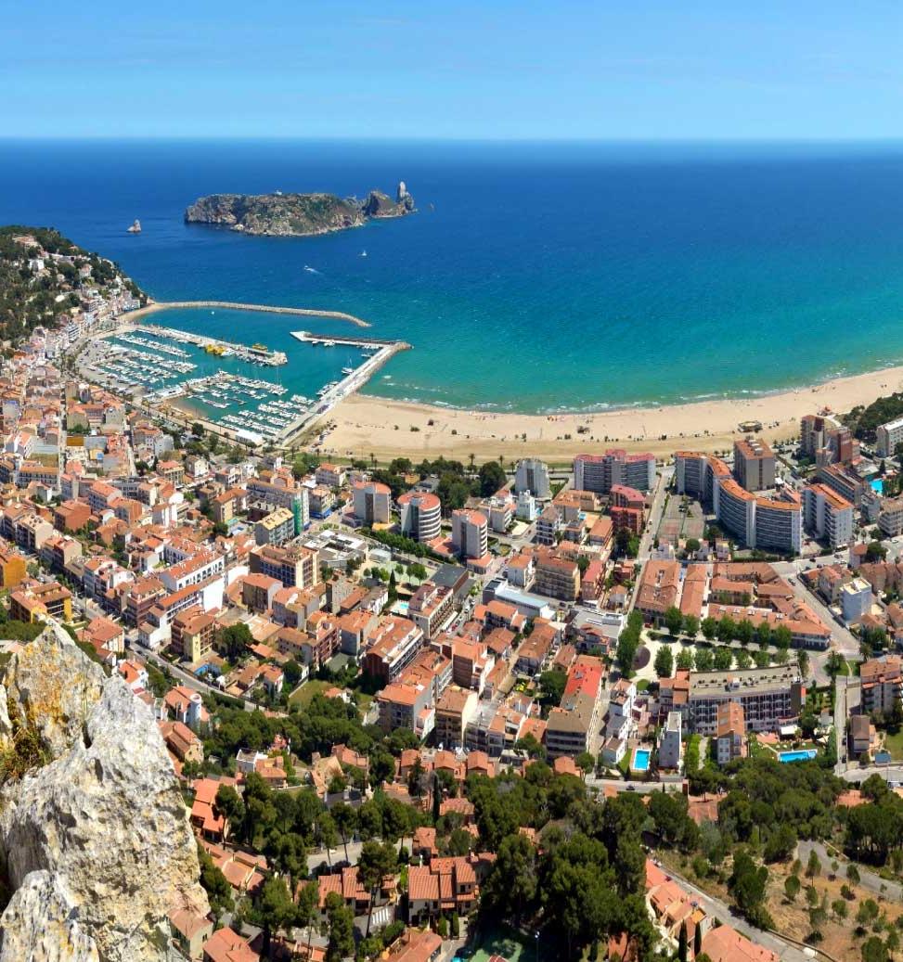
Overview
Background
Framework
Self assessment
Deeper dive
Hands on / Q&A

Slide 3
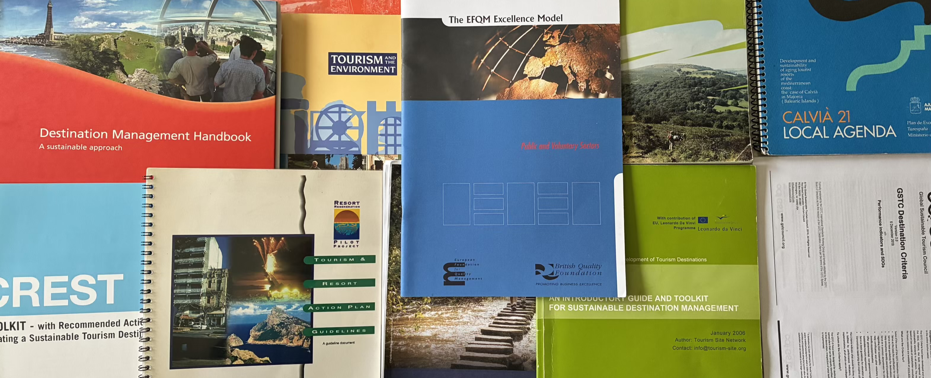
Background

Slide 4
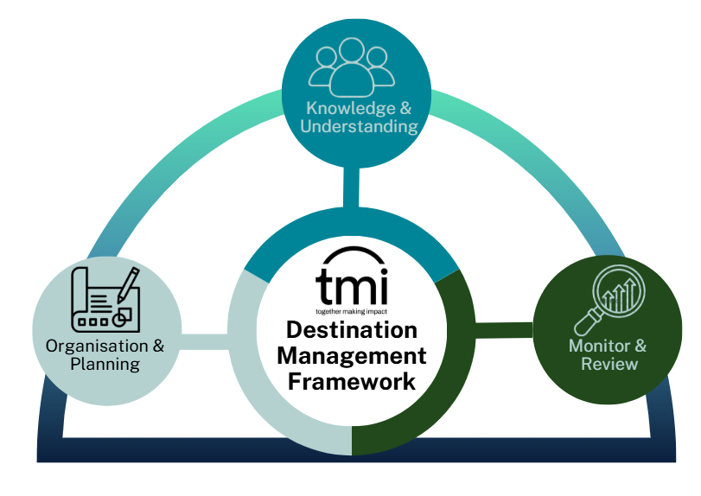
The Framework

Slide 5
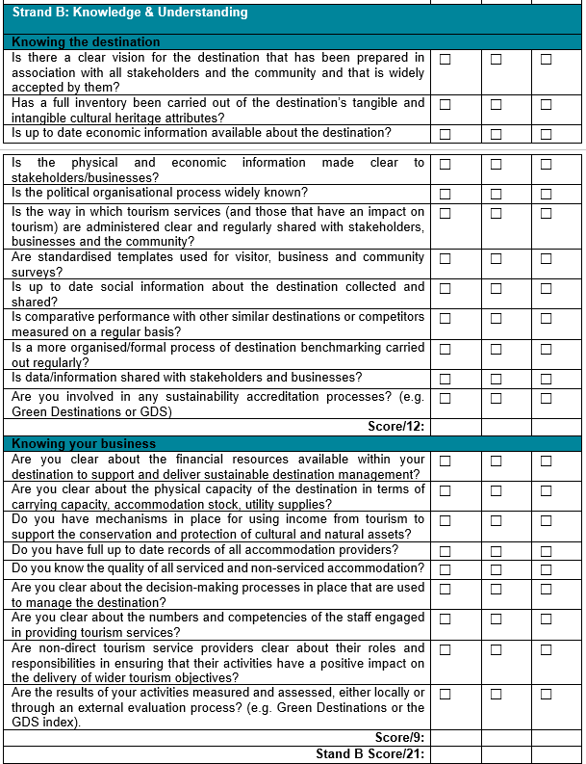
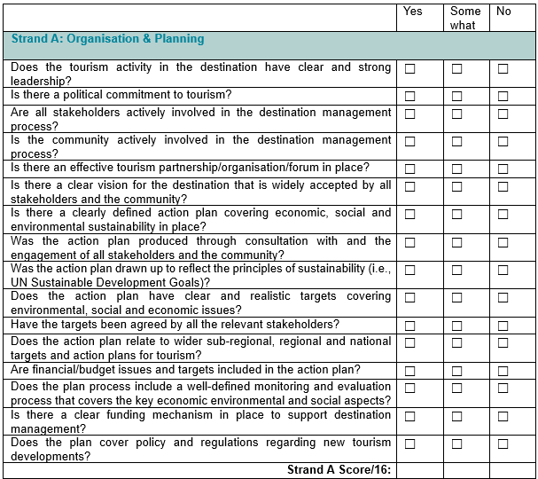
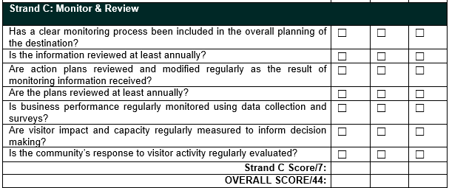
Self Assessment

Slide 6
Strand A: Organisation & Planning
Create and agree a vision in association with all stakeholders
Provide leadership
Establish an effective partnership organisation
Agree targets
Establish monitoring and evaluation processes
Produce a strategy and action plan
Manage budgets
Regularly review, amend and adjust plans as needed

Slide 7
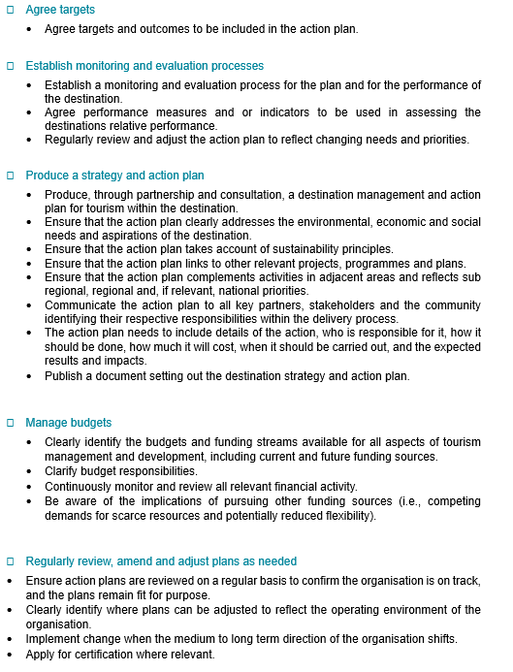
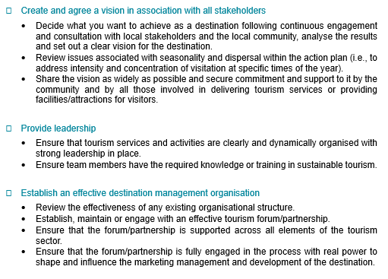
Strand A: The Details

Slide 8
Strand B: Knowledge & Understanding
Assess what you have
Assess what can be developed sustainably to cater effectively for the identified market demand
Assess distinctive elements, authenticity and inclusion
Identify and evaluate marketing activities and its effectiveness
Assess your resources
Identify relevant business/organisations and processes
Assess staff resources and capacities
Know who your customers are
Measure and evaluate business performance
Monitor, review and redevelop

Slide 9
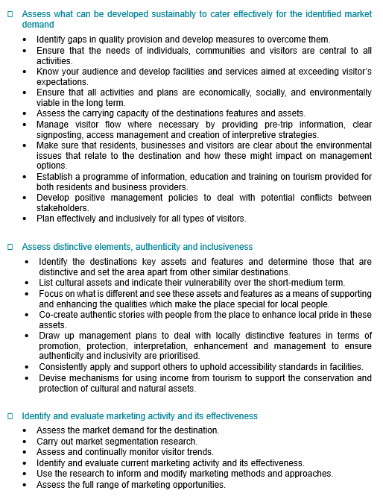
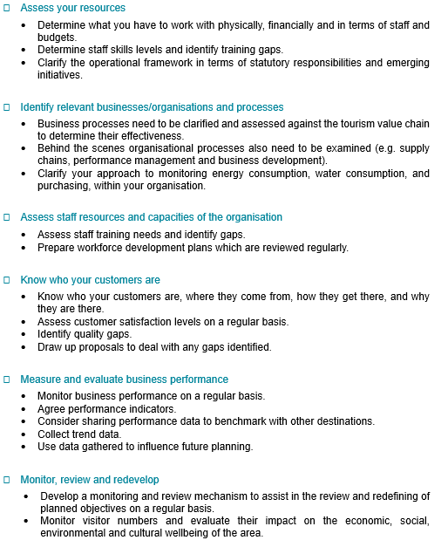
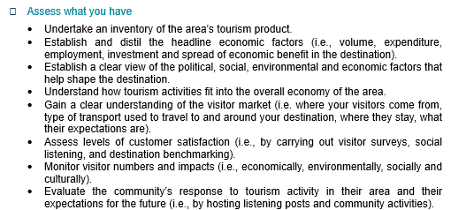
Strand B: The Details

Slide 10
Strand C: Monitor & Review
Establish a clear monitoring process
Review information regularly
Engage with destination benchmarking and consider subscribing to independent appraisal processes
Modify plans and actions accordingly
Monitor business performance
Continuously evaluate visitor impact and capacity

Slide 11
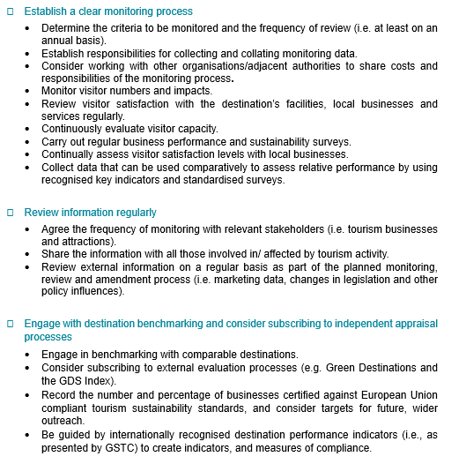
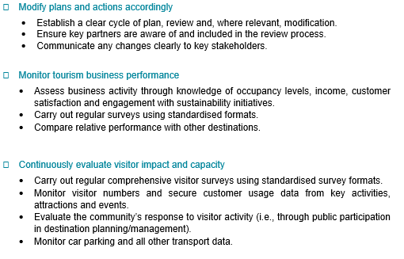
Strand C: The Details

Slide 12

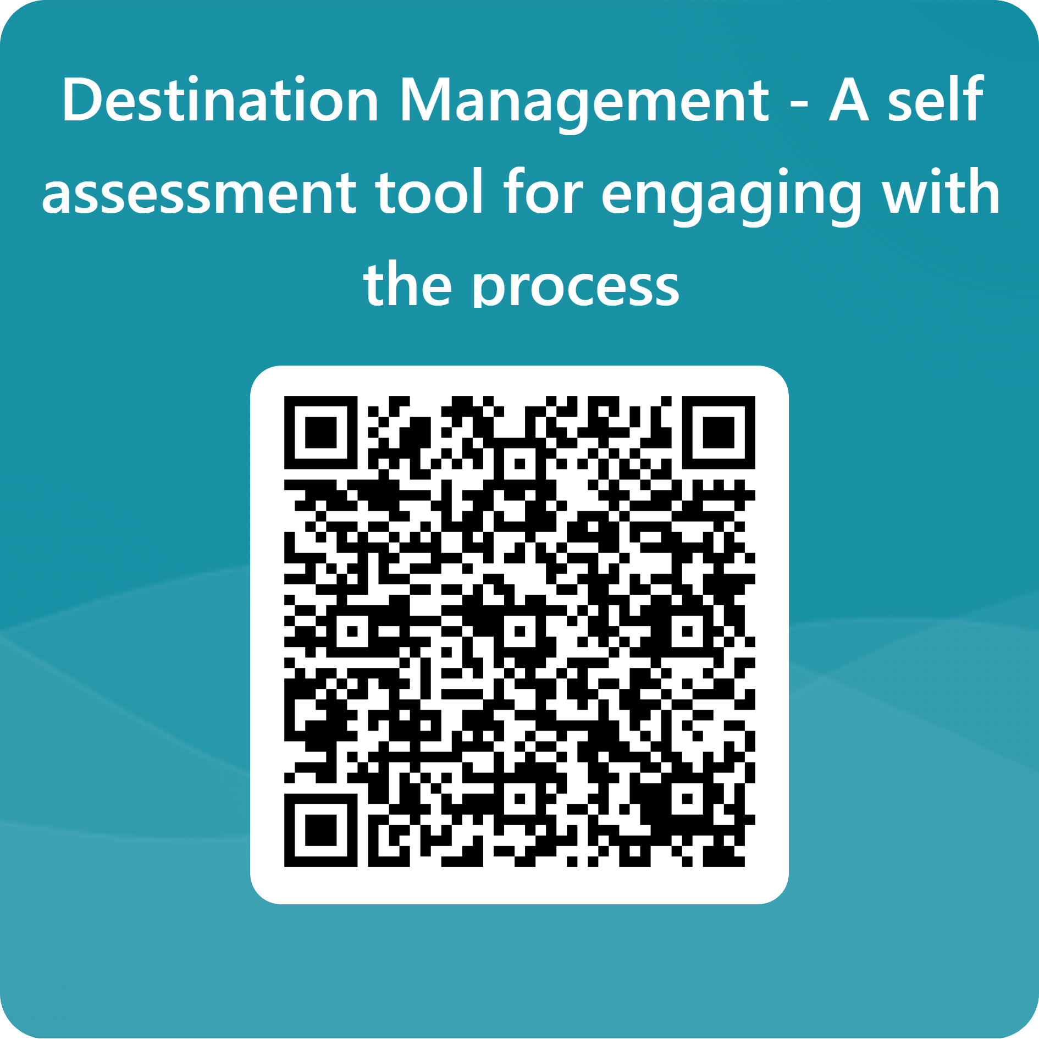
Self-Assessment Tool
To access further support material please visit the tmi Sustainability Resources page: https://www.tmi.org.uk/sustainability and if you wish to engage with the tmi Sustainability Working Group please email secretary@tmi.org.uk

